Slide 1
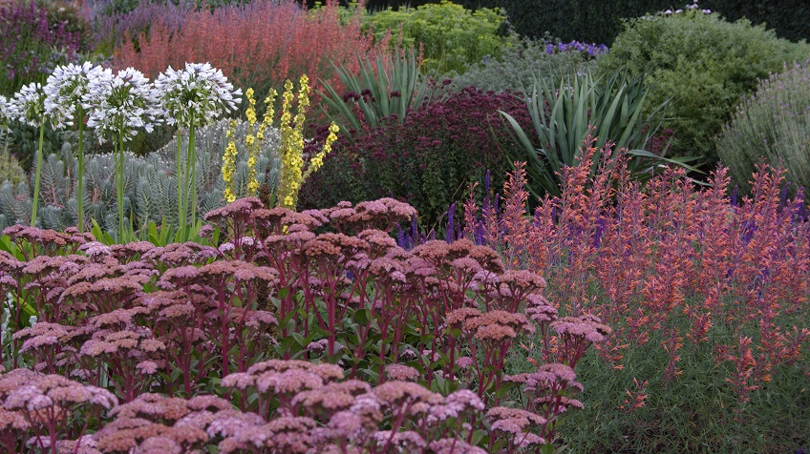

Waterwise Landscaping:
Simple Solutions to Save Water
Alison O’Connor, PhD
CSU Extension in Larimer County
Horticulture Agent
astoven@larimer.org

Slide 2
Equal Opportunity, Access, and Nondiscrimination
Colorado State University Extension is an equal opportunity provider.
Colorado State University does not discriminate on the basis of disability and is committed to providing reasonable accommodations.
CSU’s Office of Engagement and Extension ensures meaningful access and equal opportunities to participate to individuals whose first language is not English.
Colorado State University Extension es un proveedor que ofrece igualdad de oportunidades.
Colorado State University no discrimina por motivos de discapacidad y se compromete a proporcionar adaptaciones razonables.
Office of Engagement and Extension de CSU garantiza acceso significativo e igualdad de oportunidades para participar a las personas quienes su primer idioma no es el inglés.
Learn more about CSU’s Principles of Community and our Land Acknowledgement at colostate.edu.

Slide 3
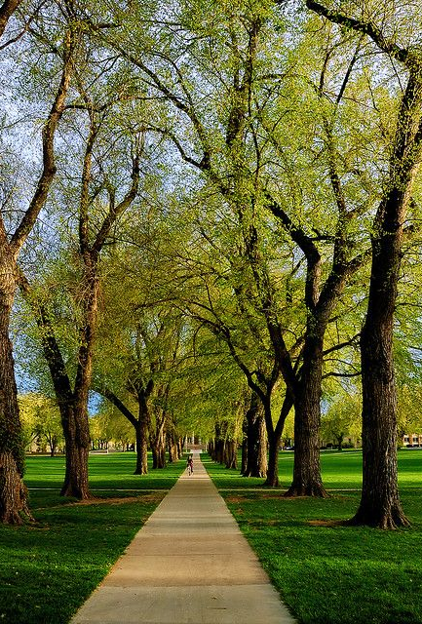
What is Extension?
Where University meets Community
We’re the outreach arm of Colorado State University (your land grant institution) that can provide you with information to use every day
Our offices have the following programs/services:
  Horticulture and Master Gardeners
  4-H Youth Development
  Food Safety and Food Preservation
  Agriculture and Natural Resources
  Community Development
  And more!
Visit extension.colostate.edu to find your county office and more information

Slide 4
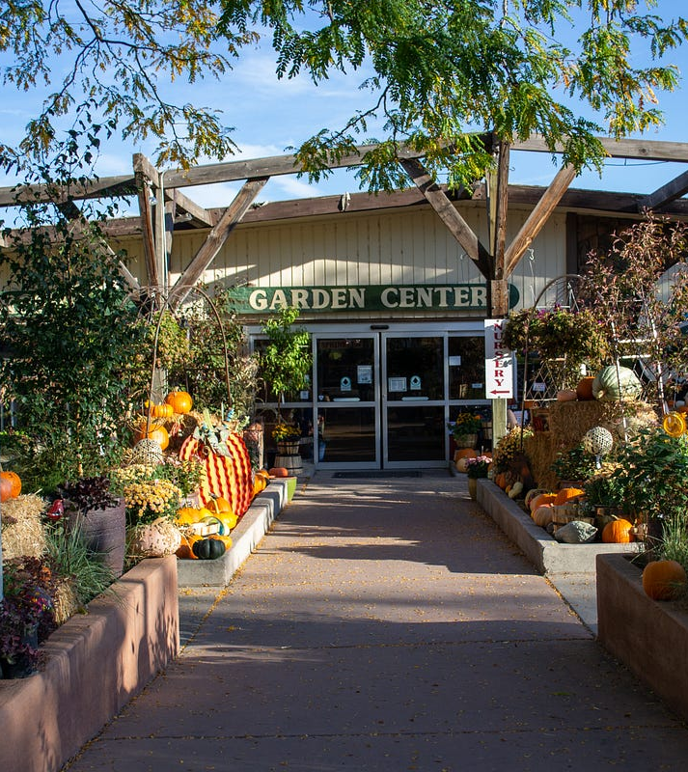
Resources available to home gardeners
CSU Extension fact sheets and other publications
Plant Select®
  Plant finder tool
  Designs
Resource Central
  Lawn replacement incentives
  Free online webinars
  Irrigation audits
  Garden-in-a-Box
Your local garden center!

Slide 5
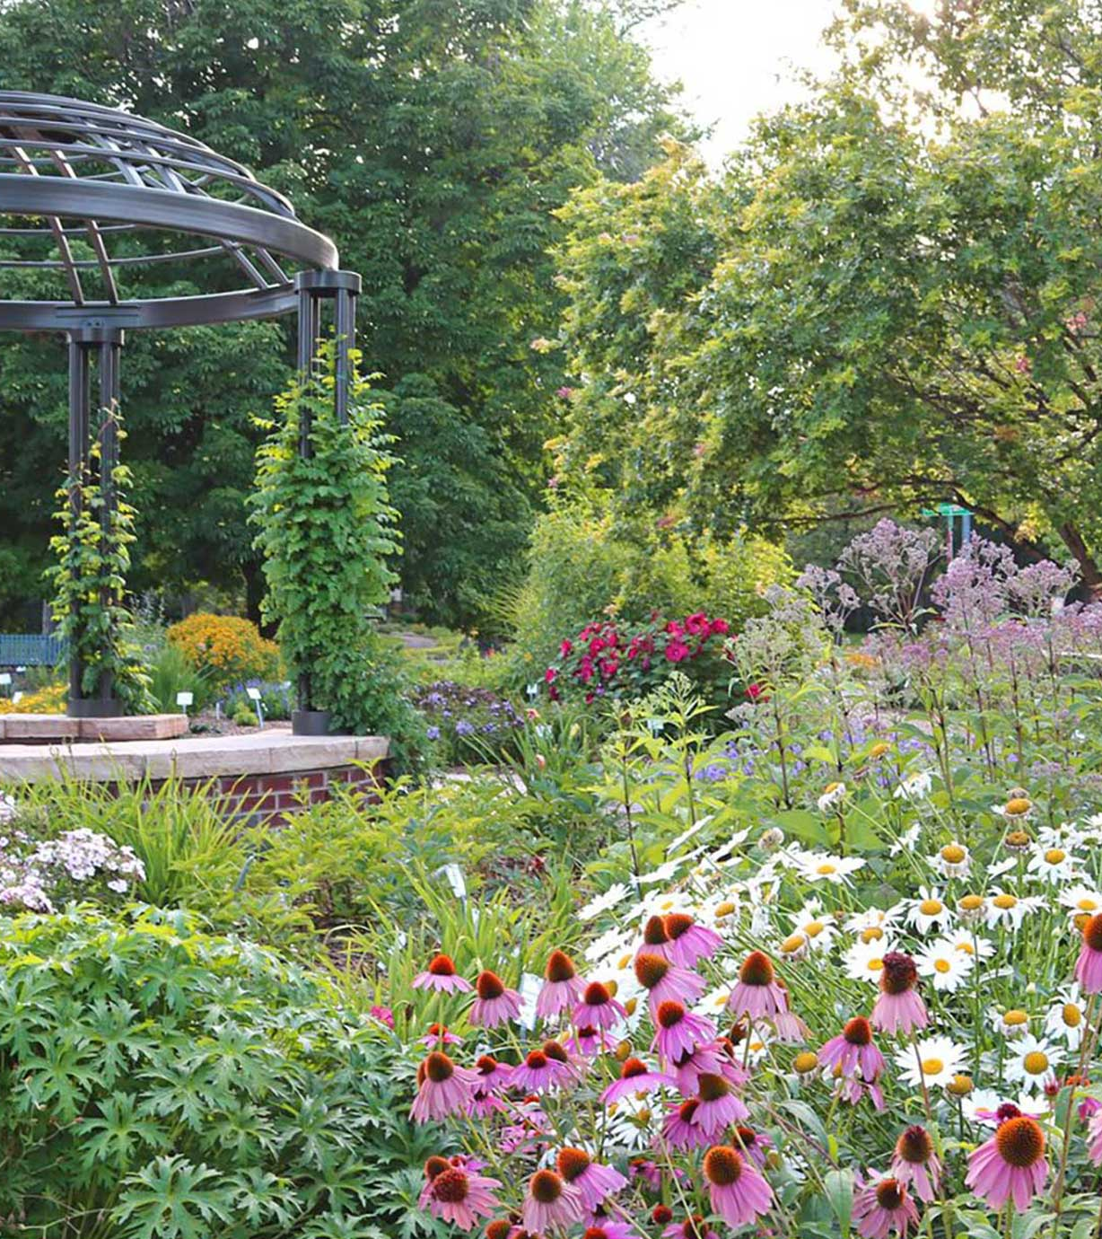
Other resources
Friends, neighbors, Master Gardener volunteers, and that “really good gardener” down the street
Local botanic gardens, like the Gardens on Spring Creek, Cheyenne Botanic Garden, or the CSU Perennial Gardens
Visit places on a regular basis throughout the year to see plants at various stages
Landscape designers

Slide 6
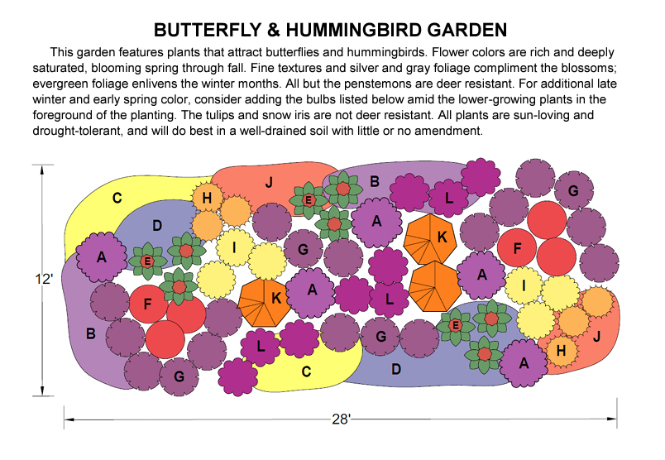
Not sure what plants go together?
Visit local demonstration and botanic gardens to see their plant pairings
Look at pre-designed landscape designs
Do as much research about the plants prior to planting
Design by Lauren Springer, Plant Select®

Slide 7

It’s not easy to garden here…
It’s not just the cold that makes things difficult
Low humidity
Fluctuating temperatures
Alkaline soils
Wind
Intense sunlight
Short(ish) growing season
Lack of water

Slide 8
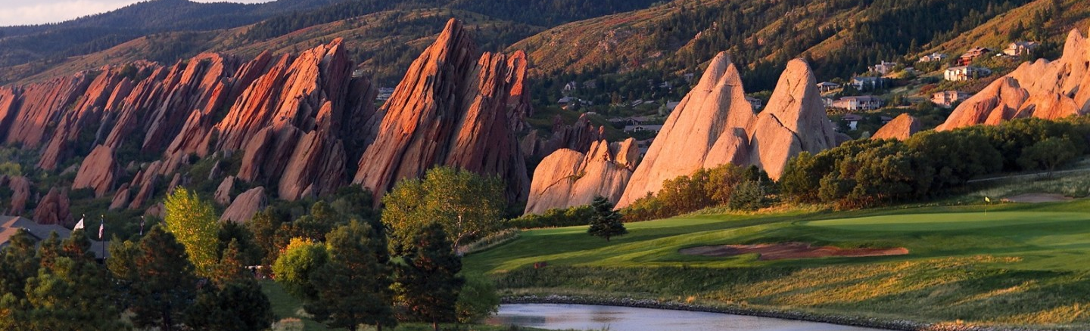
Landscapes only use 3% of the total water in Colorado
Only 40% of water that originates in Colorado remains in the state; of that water,
  A large portion of water is still used for agriculture
  ~3% is used for residential and commercial landscapes, parks, sports complexes, golf courses, etc.
In the last 15 years, Coloradans have reduced the per capita water consumption by about 20%!

Slide 9
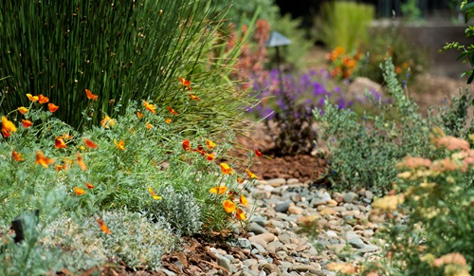
Saving water is everyone’s responsibility
We need to continue with efforts to save water
We will continue to beautify our communities with landscapes
Water-smart landscaping will save you money
It’s not that hard to make changes that result in significant water savings

Slide 10
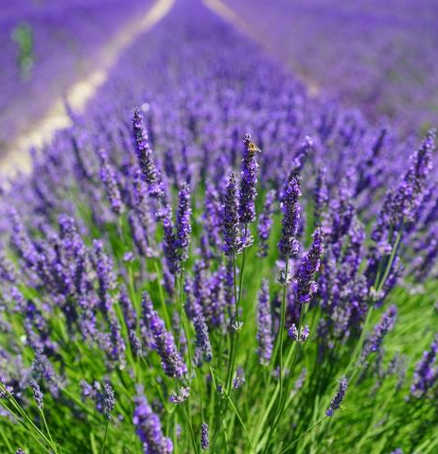
Waterwise landscape design (Xeriscape)
Plan for water conservation
Improve soil
Create practical turf and non-turf areas
Improve irrigation efficiency
Select appropriate plants
Use mulch
Maintain the landscape appropriately

Slide 11
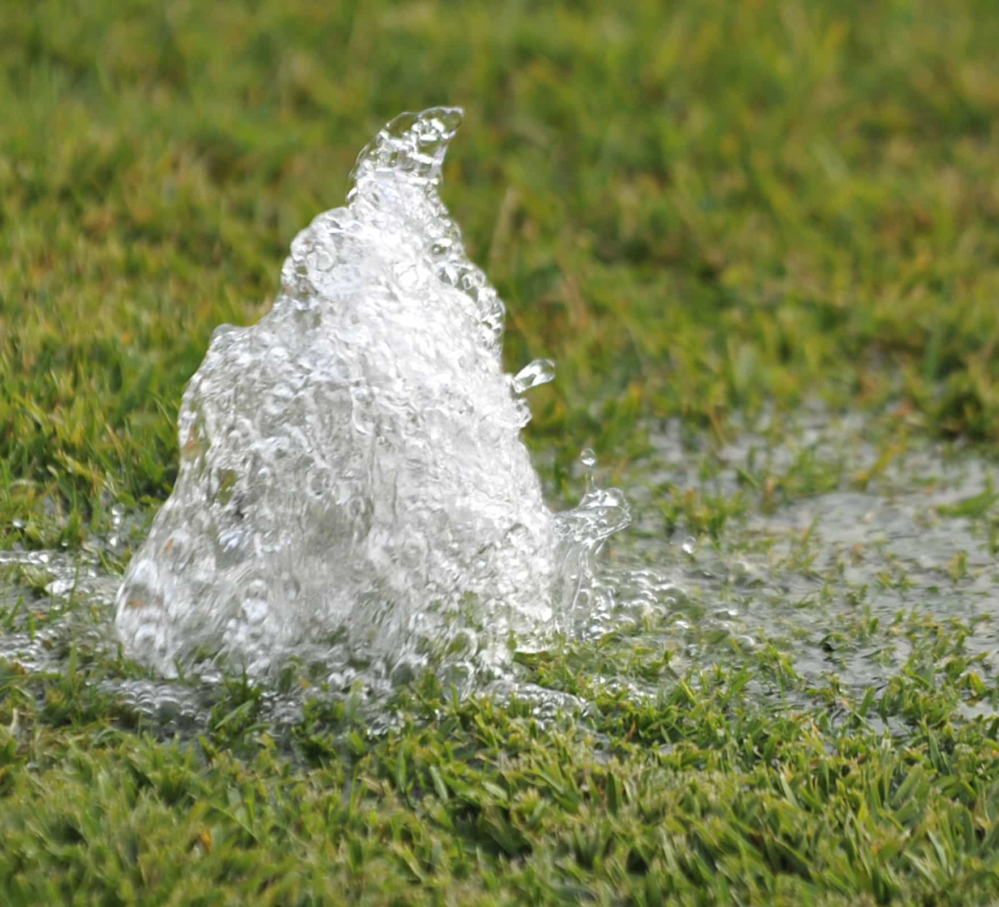
Let’s talk about irrigation
Irrigation can be a water-saving ally
There have been huge advancements in technology in recent years
  Smart controllers
  Rain or wind shut-offs
  Soil moisture sensors

Slide 12
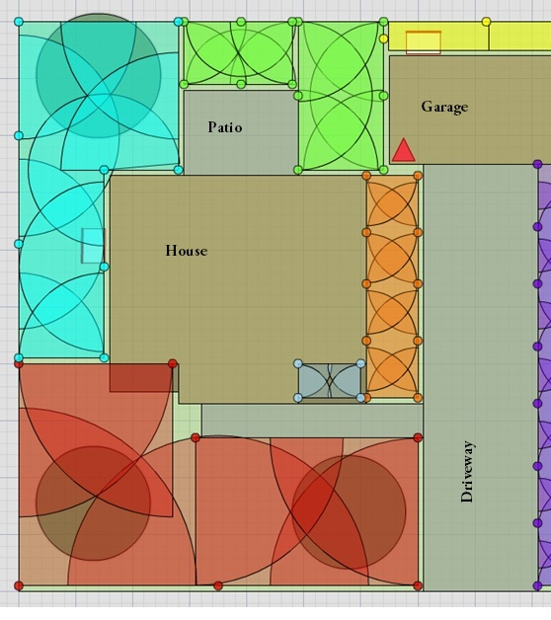
Hydrozoning is important!
Hydrozones: irrigation and planting design that clusters plants with similar water requirements together to help conserve water
Turf areas should be on separate zones from beds
Irrigate to avoid runoff and deep percolation beyond the root zone
Use drip irrigation in beds, whenever feasible
In a zone, it is critical that all heads are the same type!

Slide 13
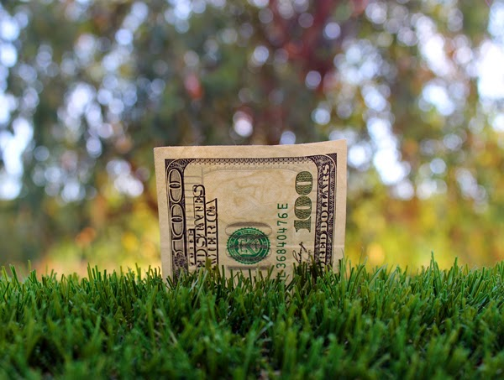
Lawns are an easy target to (try and) save water
When water becomes scarce, it’s easy to target lawns and simply encourage people to turn off the water
Rockscapes can increase ambient temperature
Nutrient and sediment run-off is increased
No place for kids or dogs to play
Weed control remains
Disjointed look to neighborhoods
Loss of carbon storage benefits

Slide 14
Unintended consequences: Cash for grass
If the turf is removed, mature plants (trees and shrubs) often remain and begin to suffer without supplemental irrigation
To maintain tree and shrub health, these plants must continue to be irrigated
If you remove turf, be sure to have a plan for watering your trees!

Slide 15
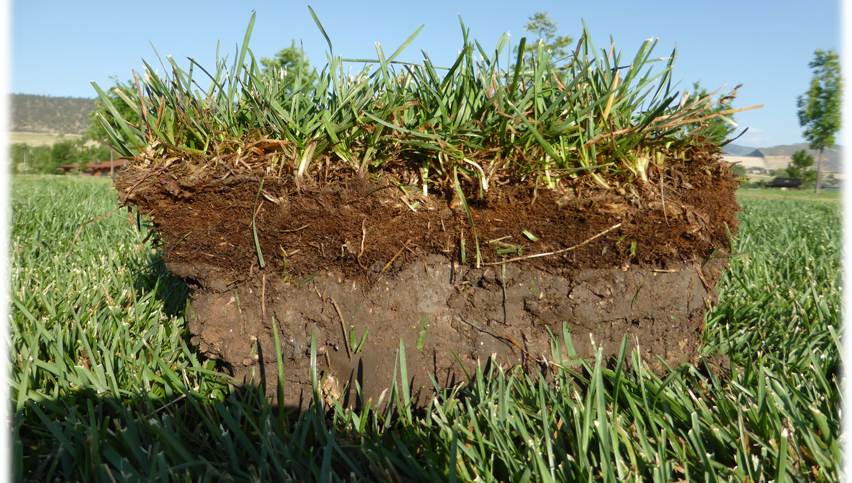
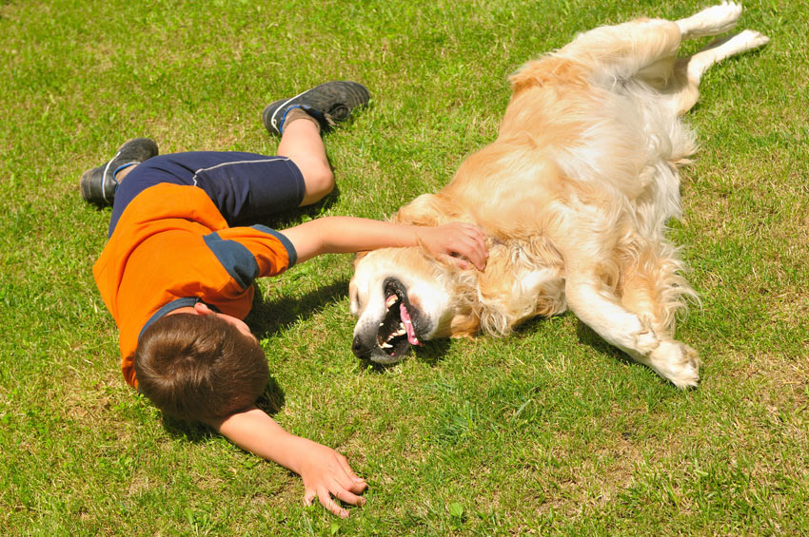
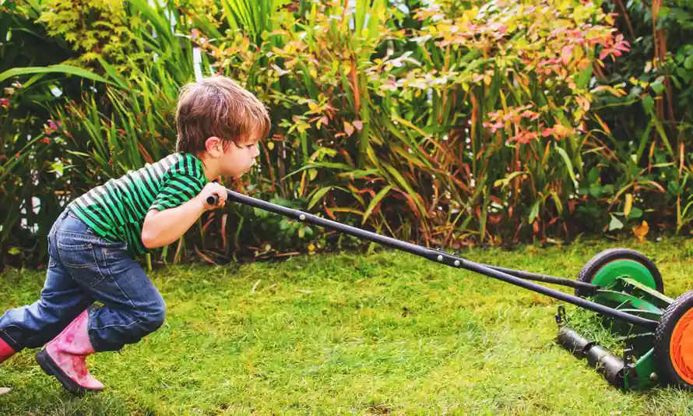
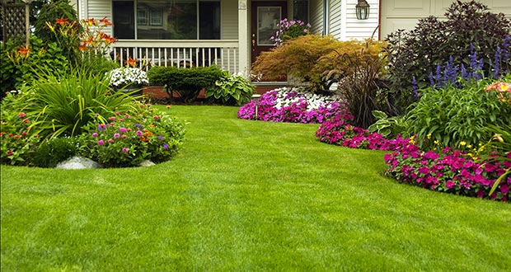
Are lawns bad? No.
Oxygen production
(grasses ARE green plants!)
A place for children, adults, pets to play and relax
Cool your home’s environment
Remove carbon from the atmosphere and store it in the roots
Huge soil microbe and insect diversity in lawns
Lawns are the most effective plant cover for preventing soil erosion
Lawns are aesthetically pleasing
Caring for a lawn is good exercise

Slide 16
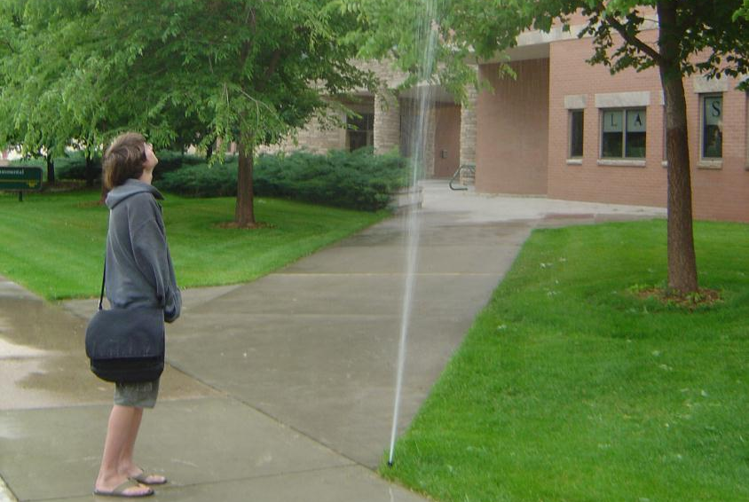
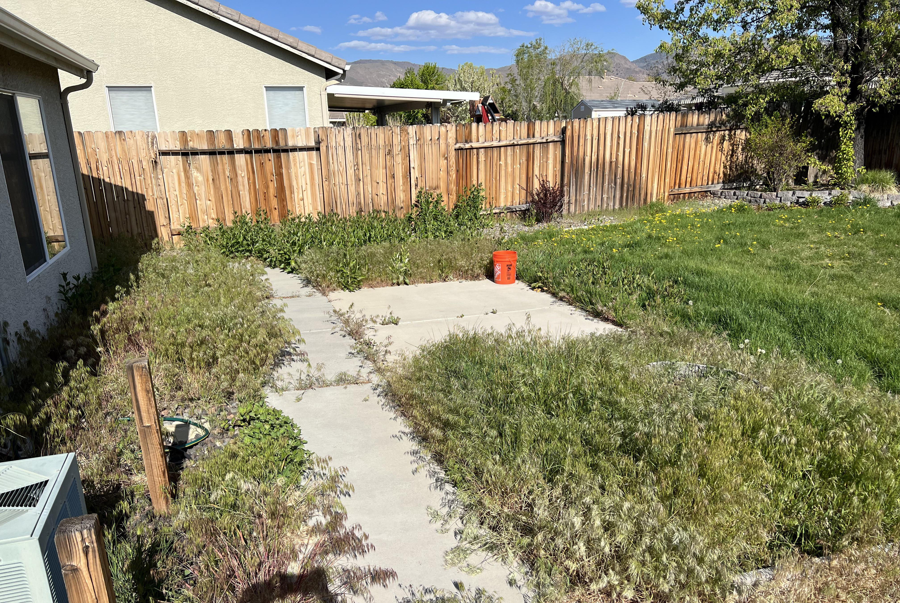
Are lawns mismanaged?
They can be, just like other plants.

Slide 17
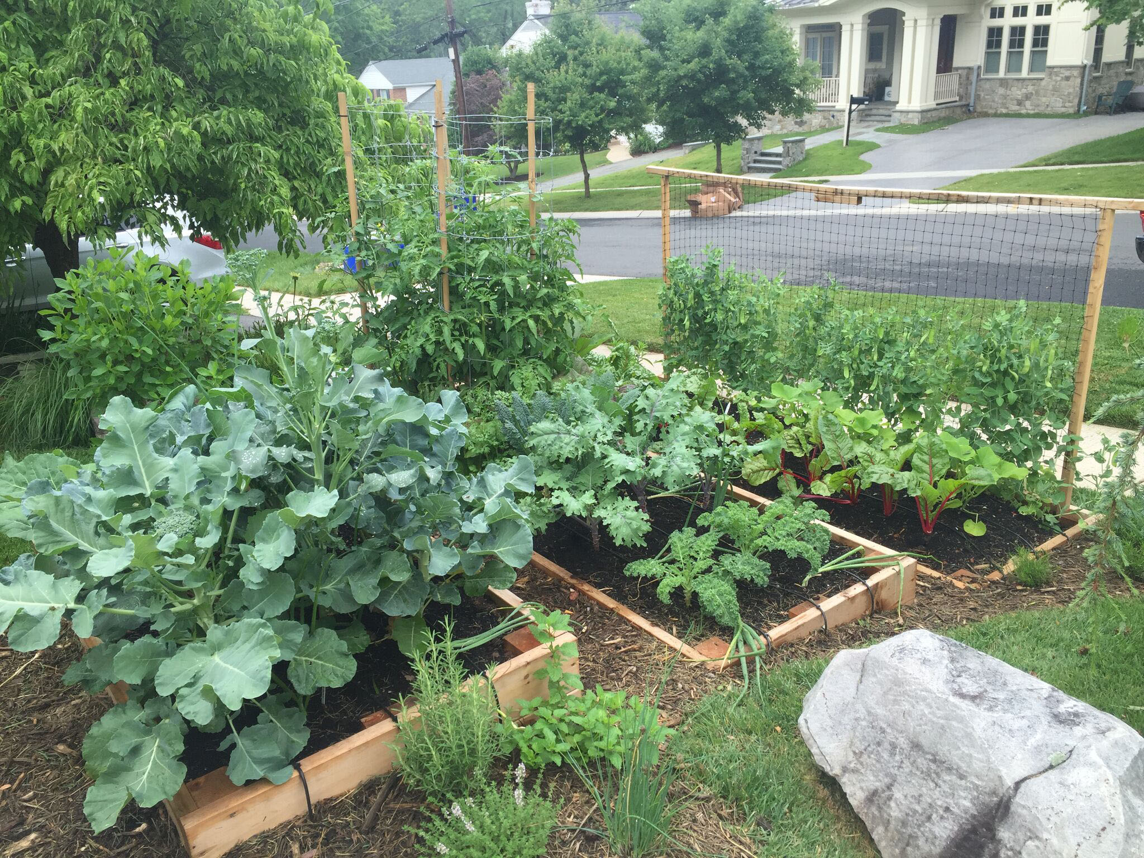
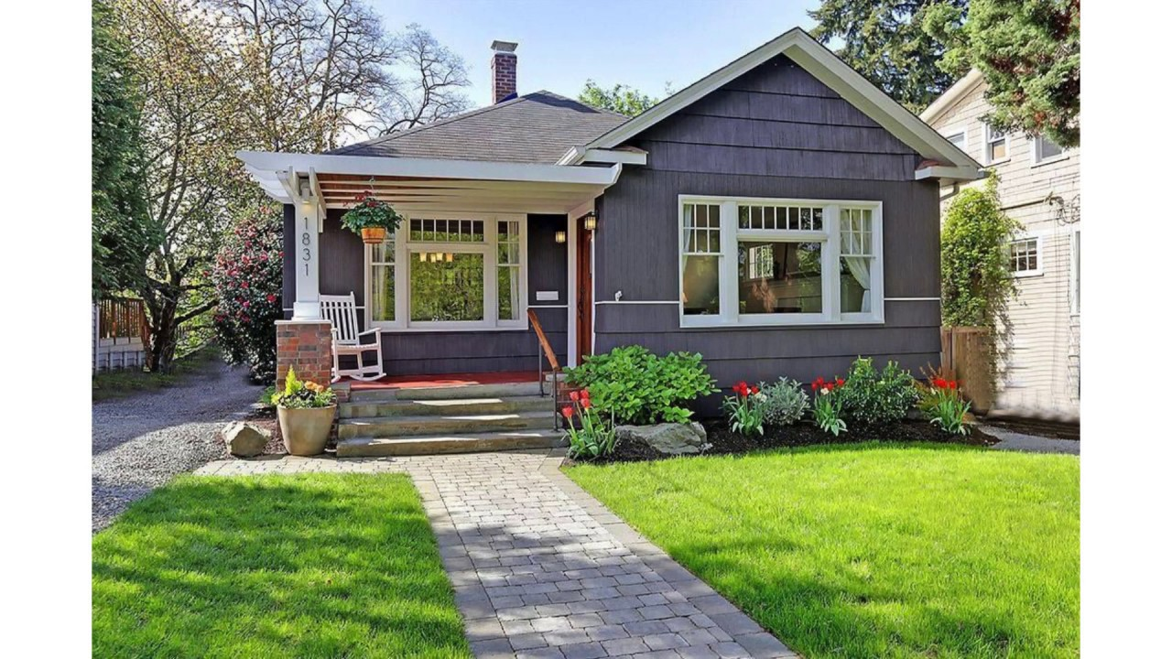
Be kind…and don’t “shame”
There are legitimate reasons to have lawns, and everyone is allowed to make decisions that are best for them
In terms of plant demand, lawns are, BY FAR, the easiest aspect of landscapes to maintain and manage

Slide 18
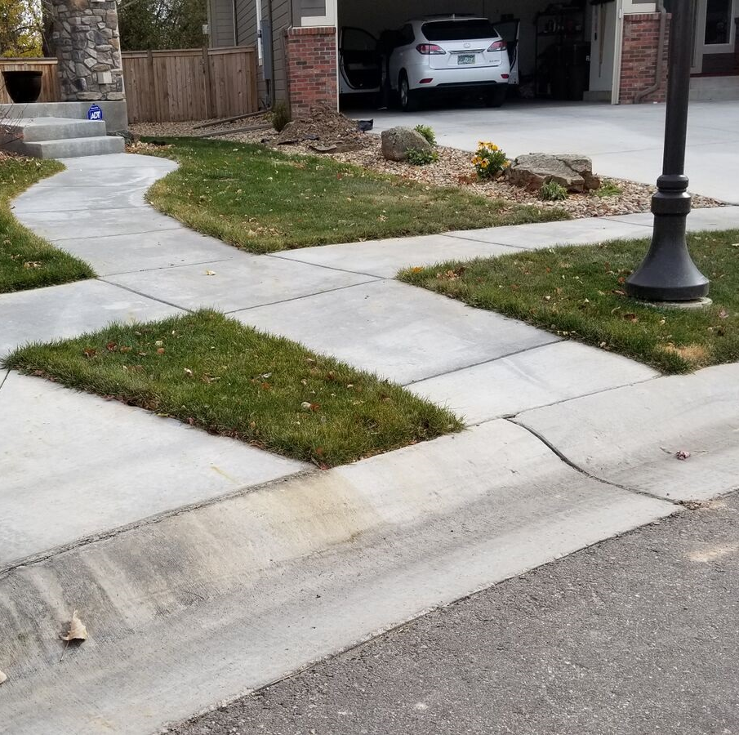
Also! Let’s call it
“non-essential” turf
“Non-functional” implies that the turf isn’t worthwhile or doing anything for our communities – and this isn’t true
There are many “stupid” or “non-essential” turf areas that might benefit from renovation

Slide 19
Lawn Tip #1: Get to know your controller
Aim to run your lawn sprinklers based on need not on a schedule
When you turn on the sprinklers in the spring, don’t set the clock for the season
  You’ll water more in August than in June
It’s better to manually control the irrigation clock
  Water when the lawn needs it
  Turn it off when it doesn’t

Slide 20
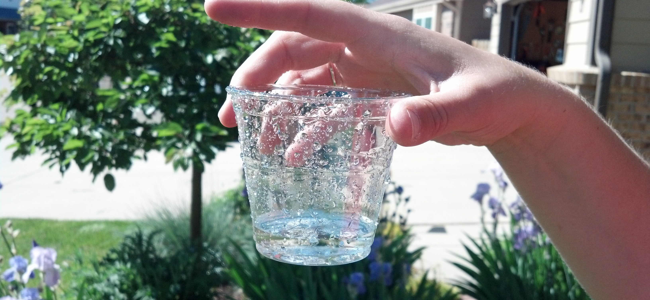
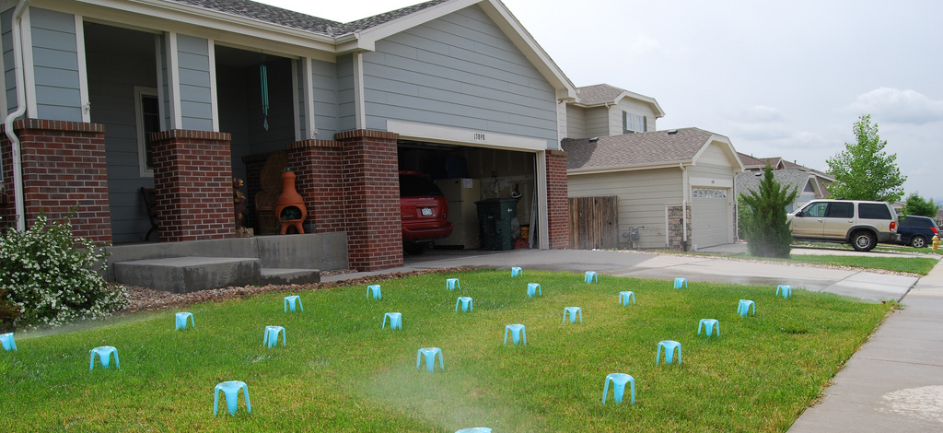
Turf Tip #2:
Do an irrigation audit
Do you know how much water you’re applying during each irrigation cycle? If not, then do a simple catch can test
Set out 10-12 cups in an irrigation zone
Run the system for 20 or 30 minutes
Measure the water

Slide 21
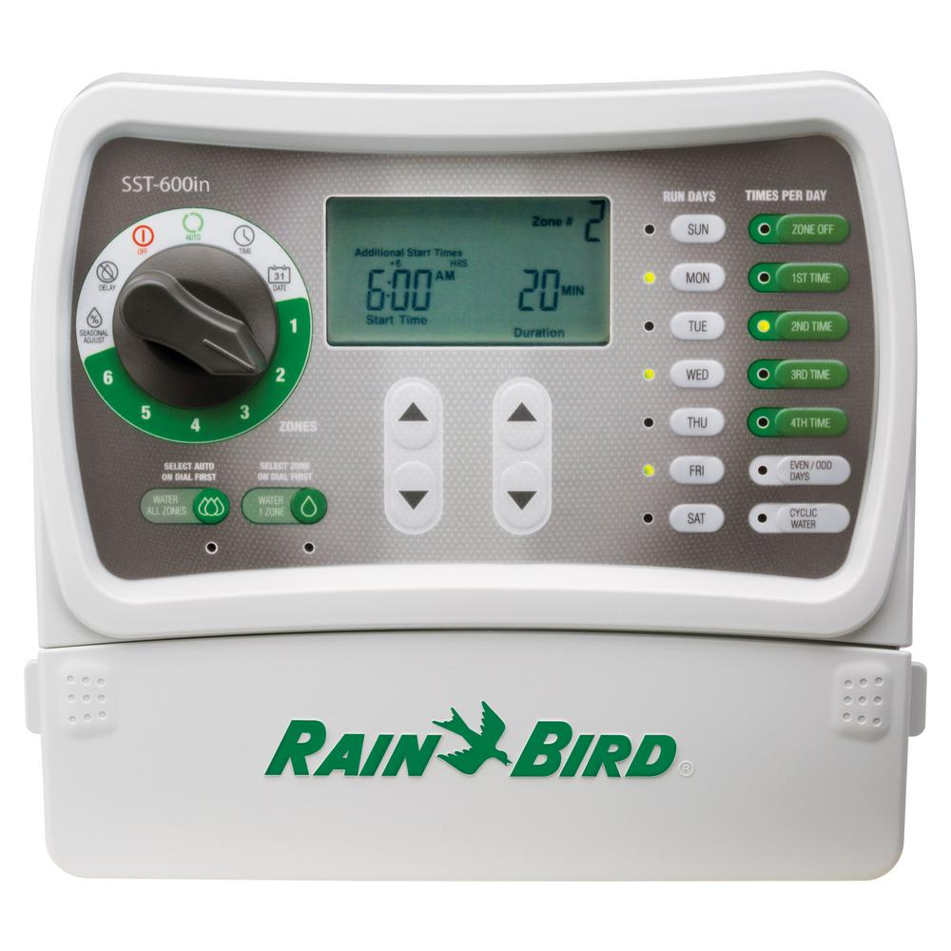
Turf Tip #3: Reduce your run times
Save 10% of your water use by reducing your run times by 10%
…and then push it to 20%
It’s unlikely that you’ll notice a difference in the turf quality or appearance
And you’ll save money….and water!
30 minutes
  10% = 27 minutes
  20% = 24 minutes

Slide 22
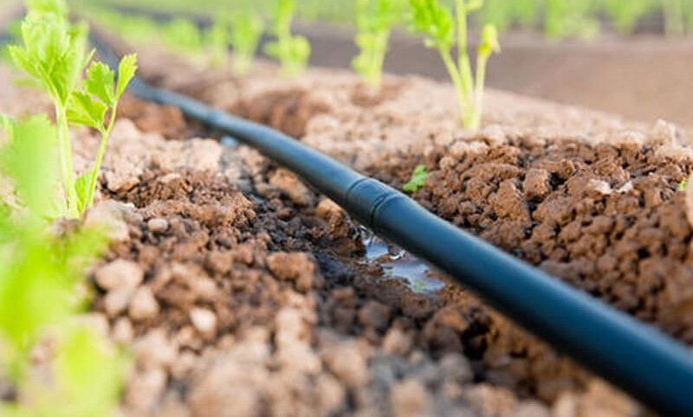
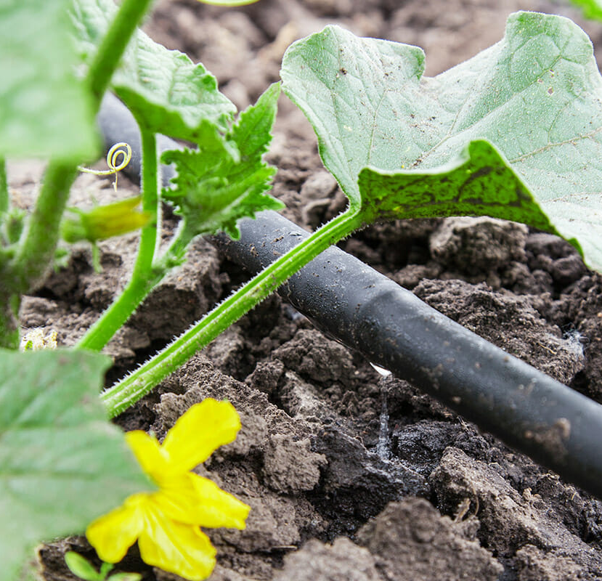
Drip irrigation efficiency
Targeted water application
Greater than 90% efficient
Lower total water use
Low pressure
Decreased weed and disease pressure

Slide 23
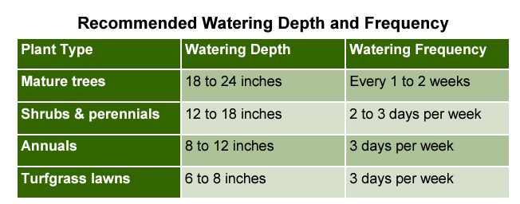
Drip irrigation frequency

Slide 24
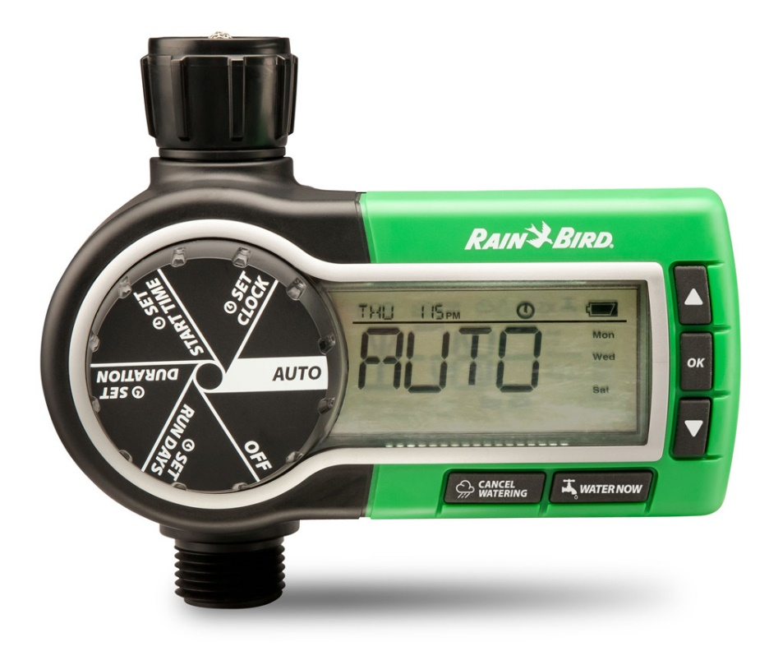
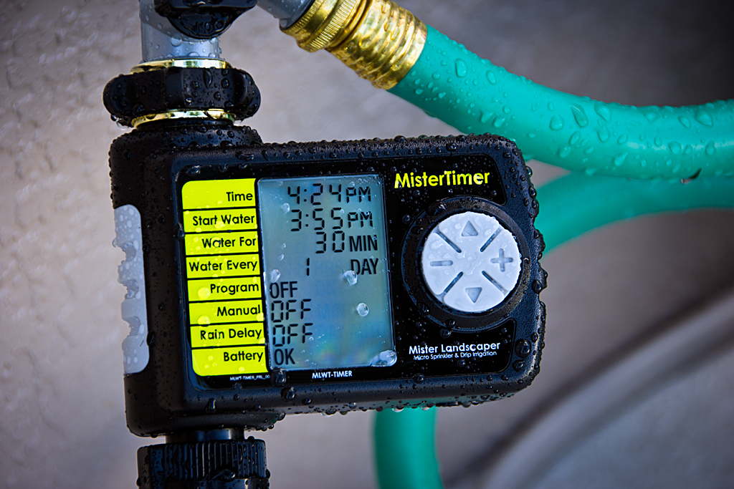
Timers to control drip systems

Slide 25
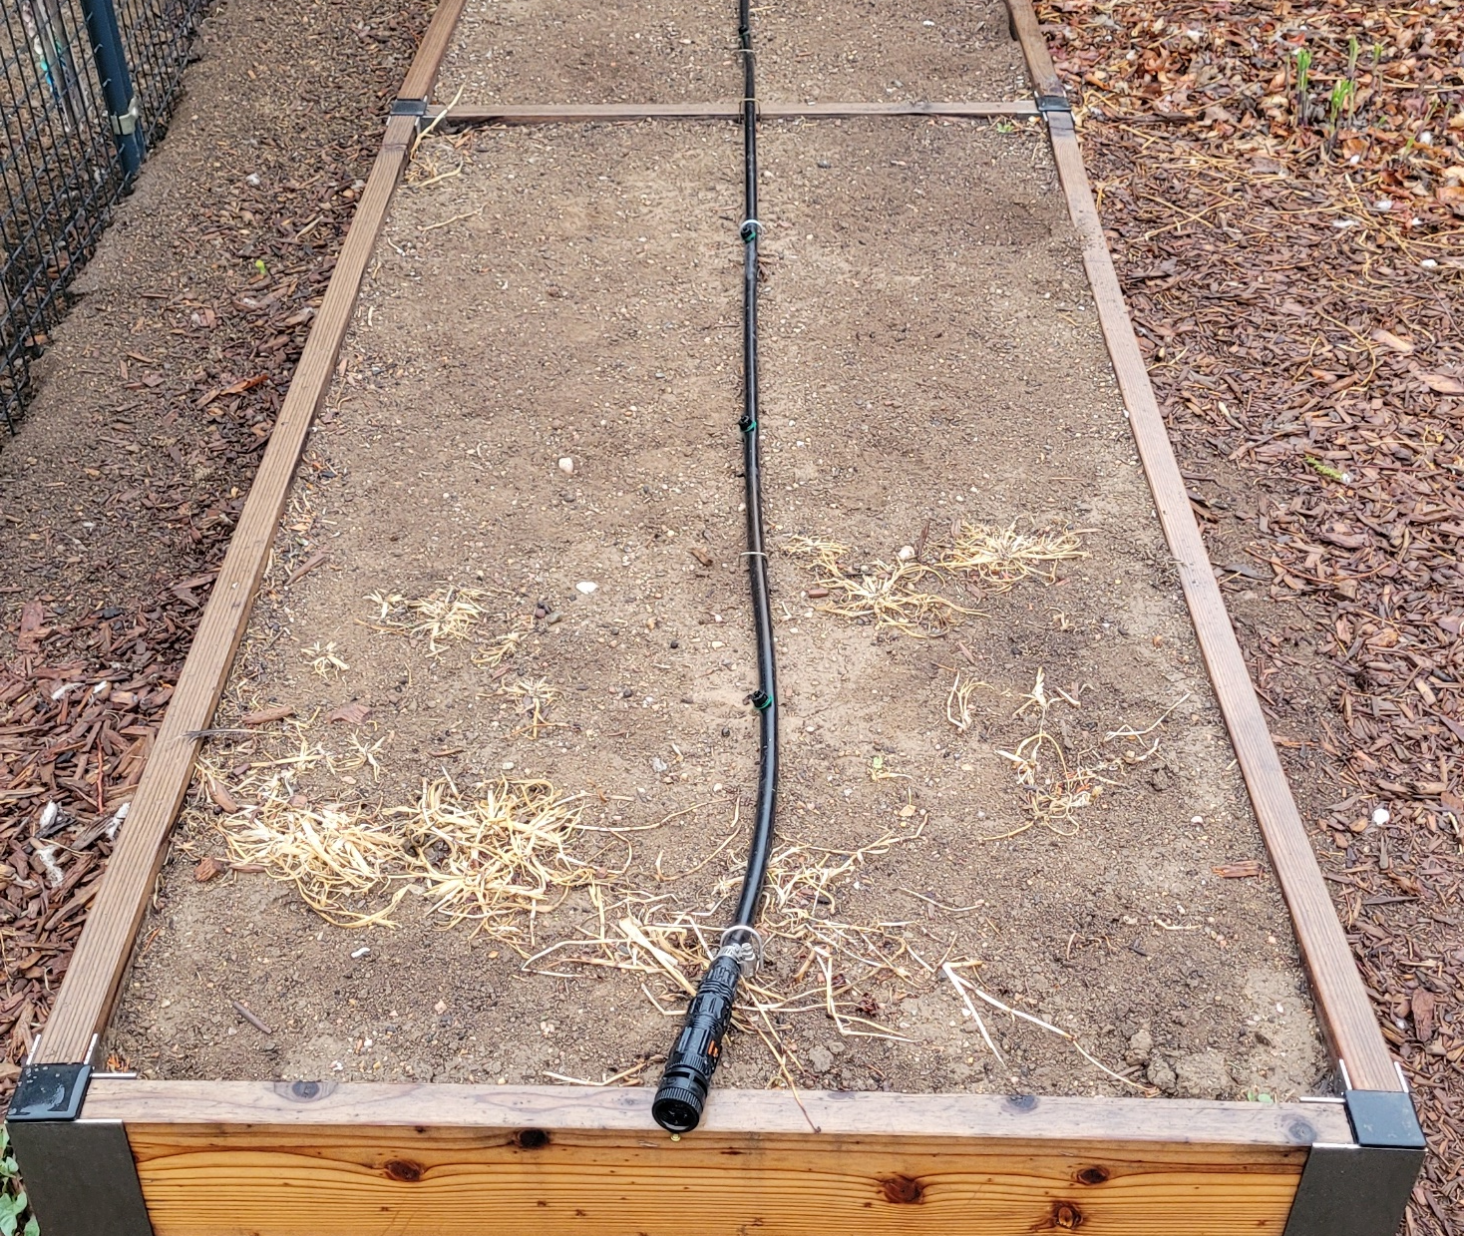
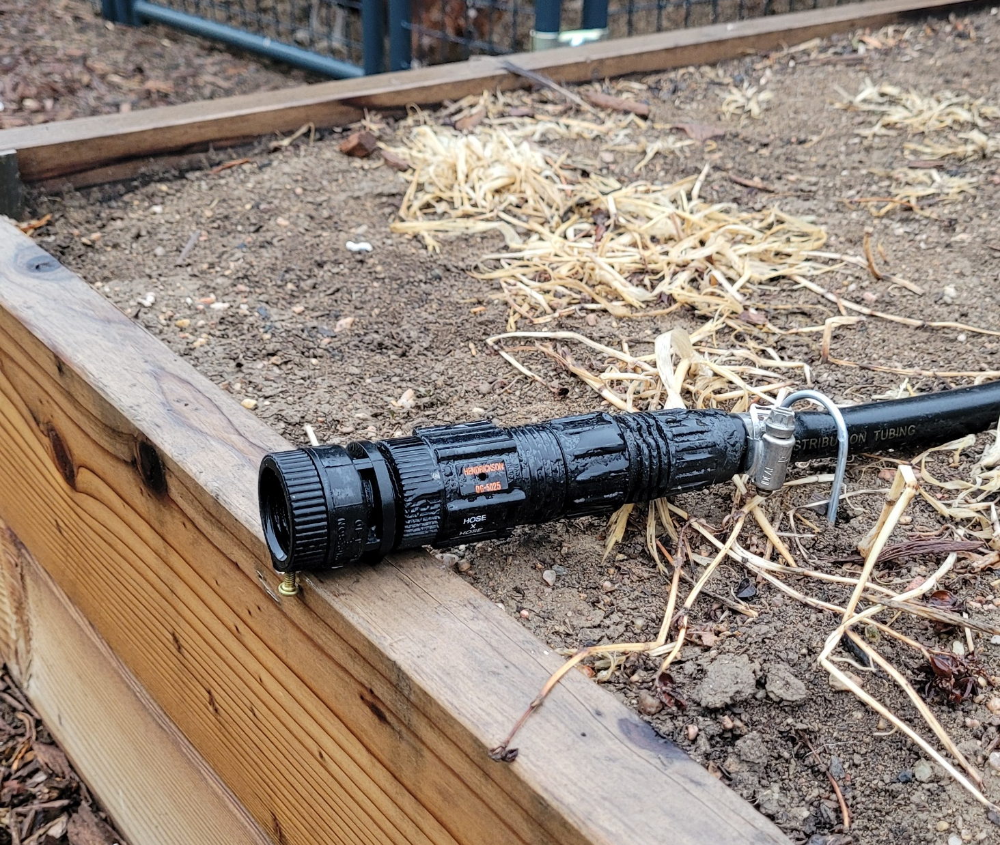
You can connect drip to your garden hose

Slide 26
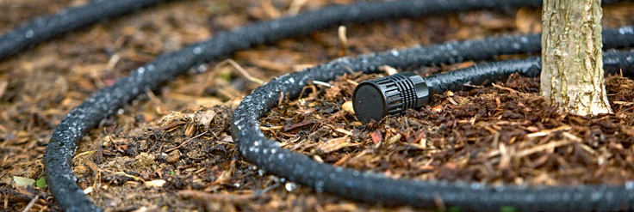
Irrigation of trees and shrubs
Can use drip irrigation, moving lines out as the plants become larger and more established
Can use turf sprinklers, if woody plants are near/in the lawn
Can use hose sprinklers, focusing watering efforts at the dripline of the trees

Slide 27
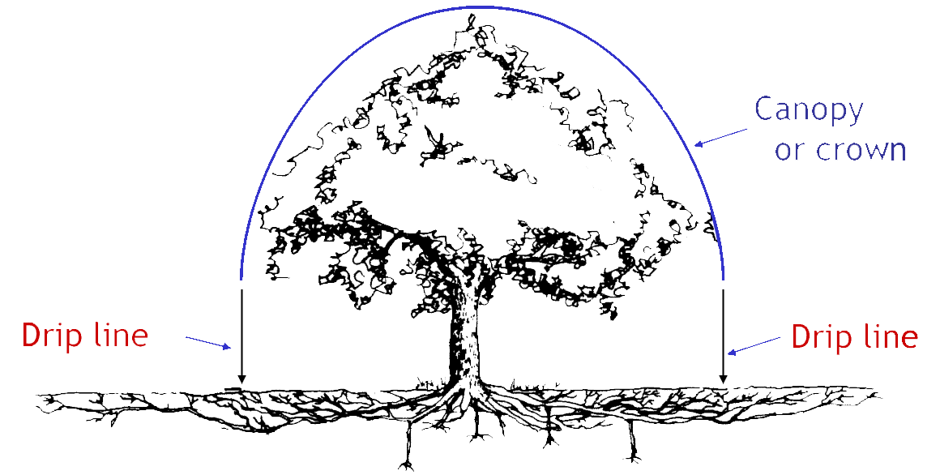
Where to water landscape trees
All water-absorbing roots are located at the dripline – there are no water-absorbing roots within six inches of the trunk (except when the tree is newly planted)
Water-absorbing roots are located within the top 24” of the soil

Slide 28
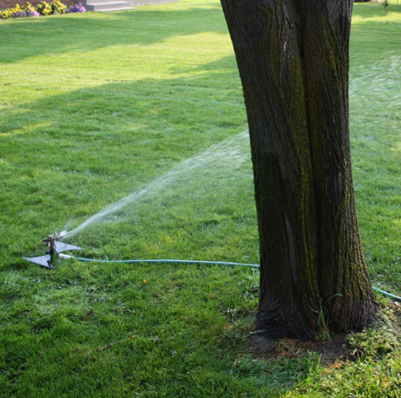
What should I use to water?
Most effective:
  Lawn irrigation
  Soaker hose
  Above-ground sprinkler
  Drip irrigation designed just for that tree

Slide 29
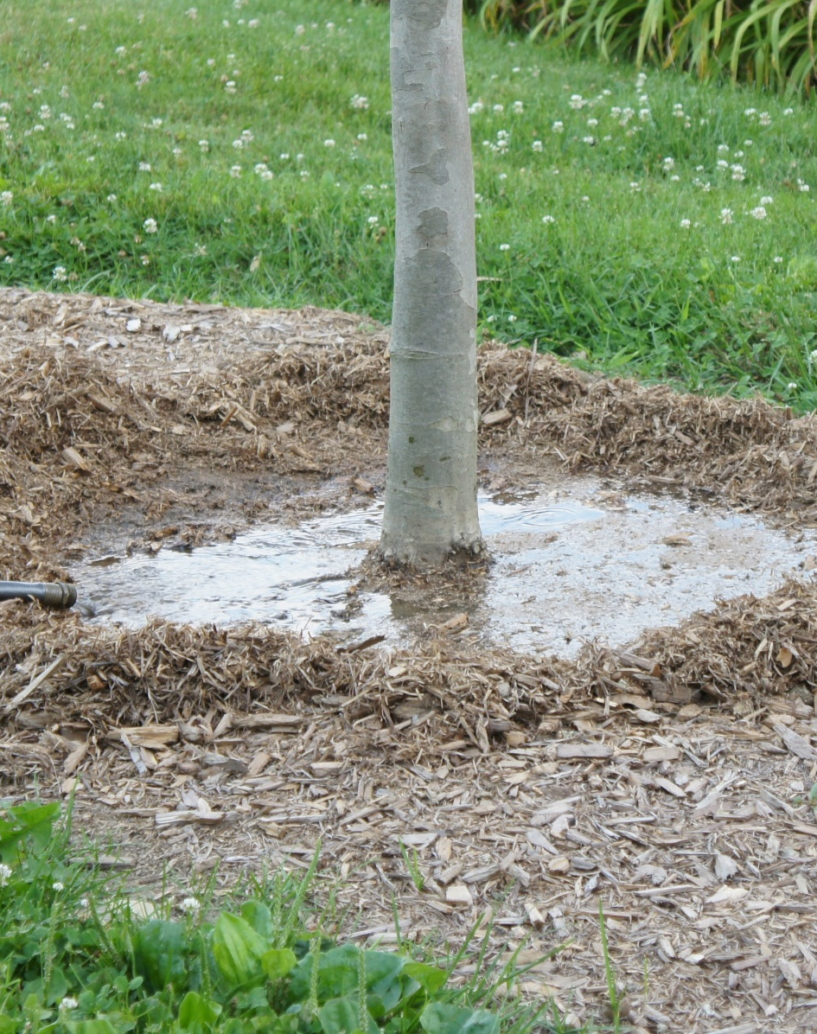
Watering recommendations for newly planted trees
Water daily one to two weeks after planting
Then for the next three to 12 weeks after planting, water every two to three days
After 12 weeks, water weekly until roots are established
During establishment, apply water directly to the root ball

Slide 30
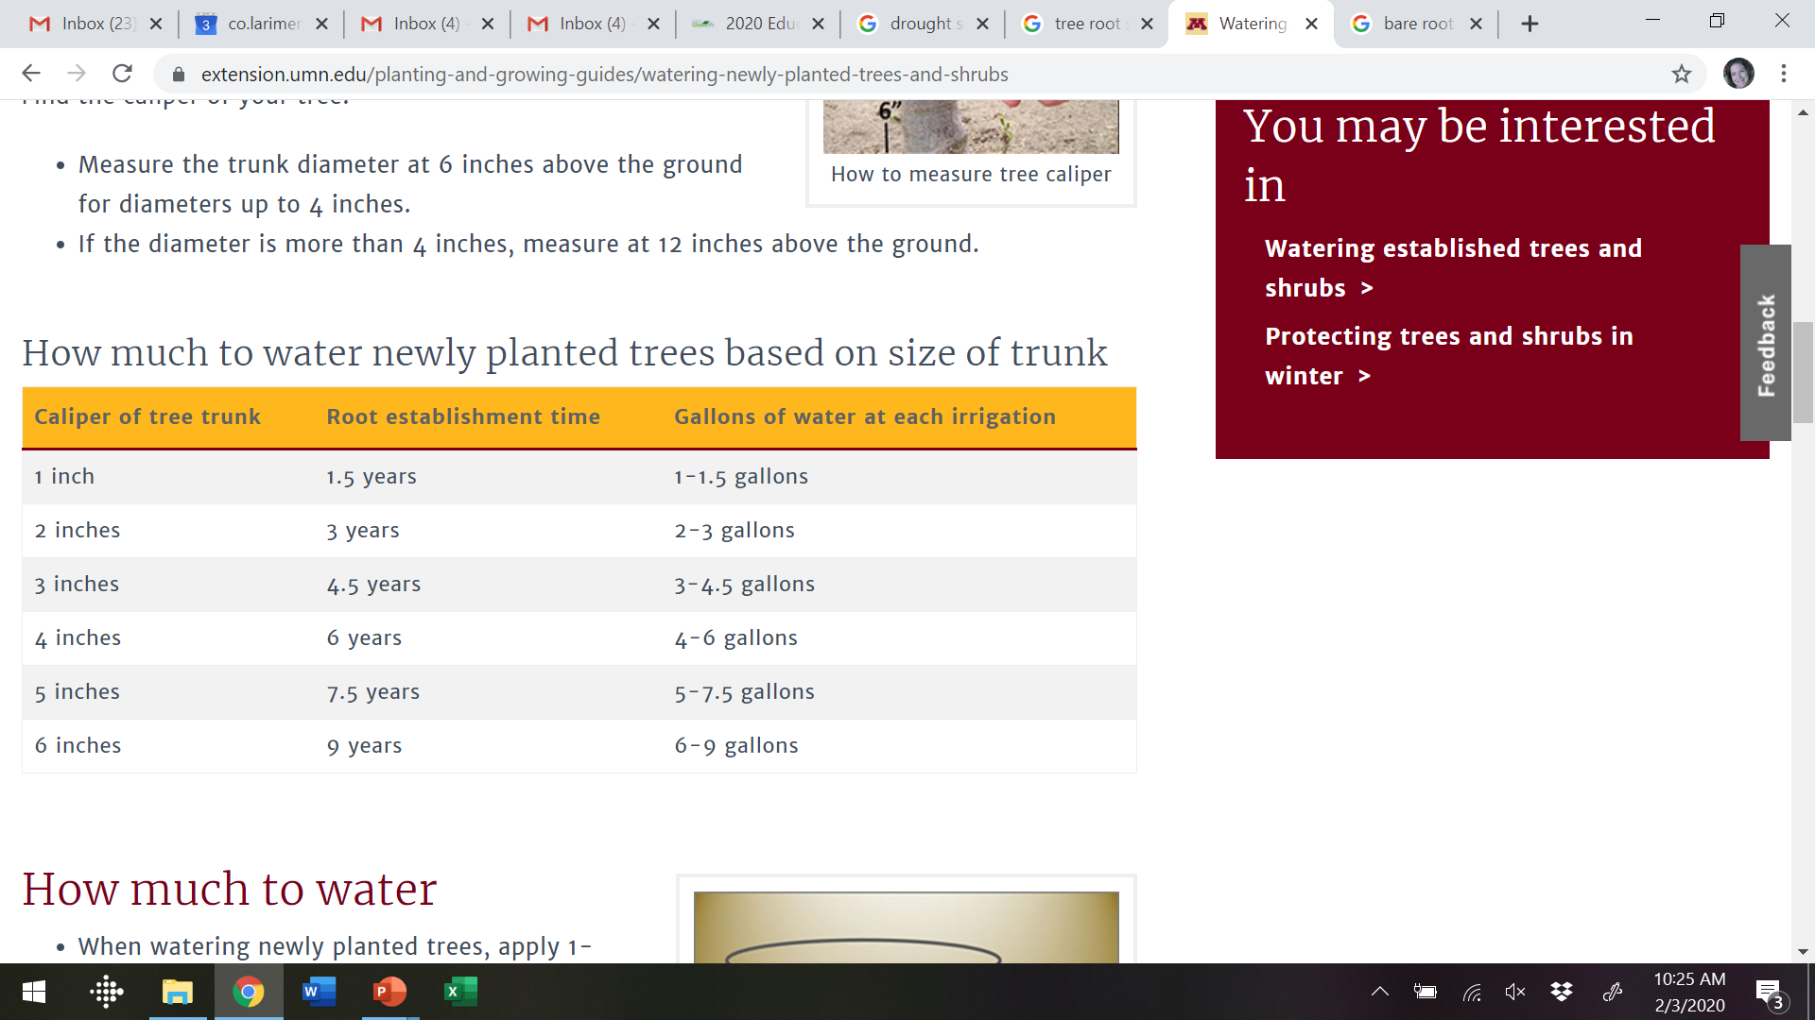
Water daily one to two weeks after planting
Then for the next three to 12 weeks after planting, water every two to three days
After 12 weeks, water weekly until roots are established
University of Minnesota: “Watering Newly Planted Trees and Shrubs”

Slide 31
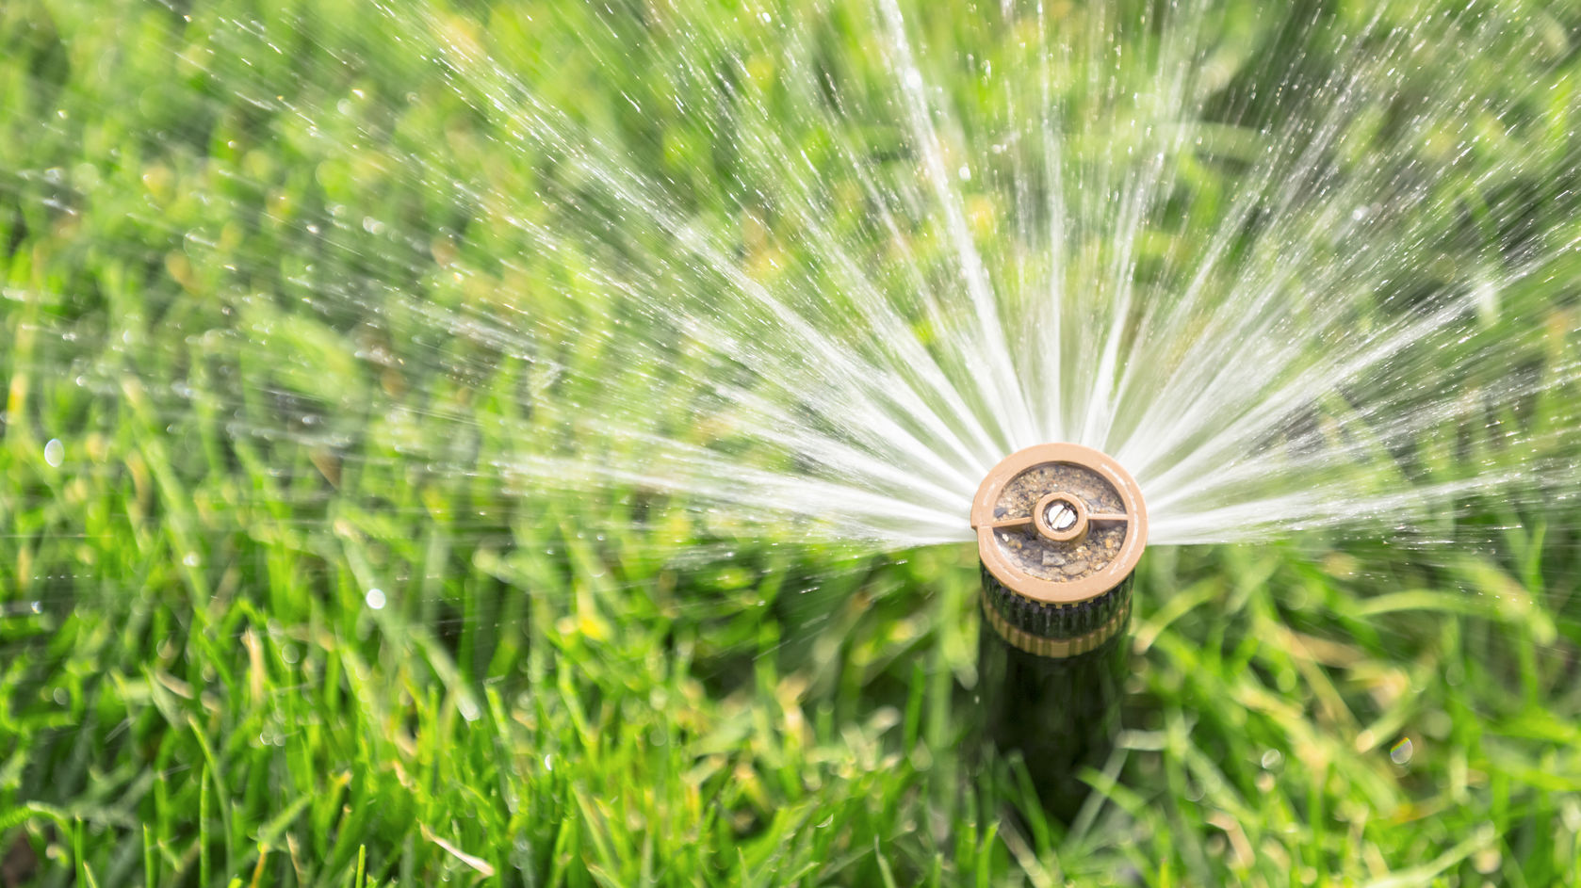
Lawn sprinkler irrigation for newly planted trees is probably not enough
If you’re managing your lawn sprinklers in a water-efficient manner, they will not provide enough irrigation to water newly planted trees
Plus, the lawn will have the advantage because it has a more extensive root system

Slide 32
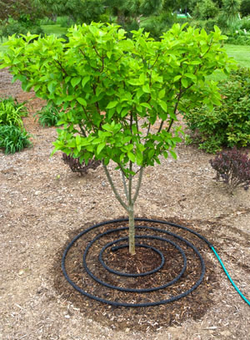
If you’re using drip, monitor the water
Drip irrigation is easy to “set it and forget it”
Drip irrigation must be constantly monitored to ensure it’s working properly and not applying too little or too much water

Slide 33
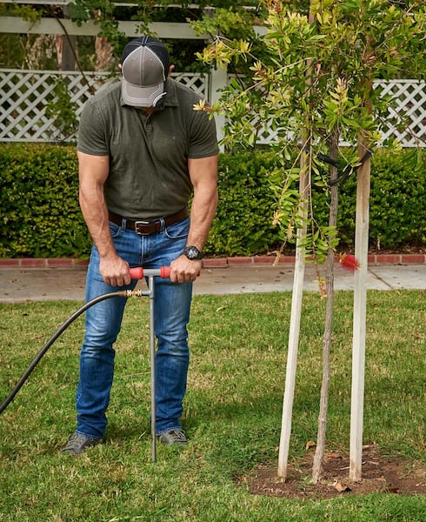
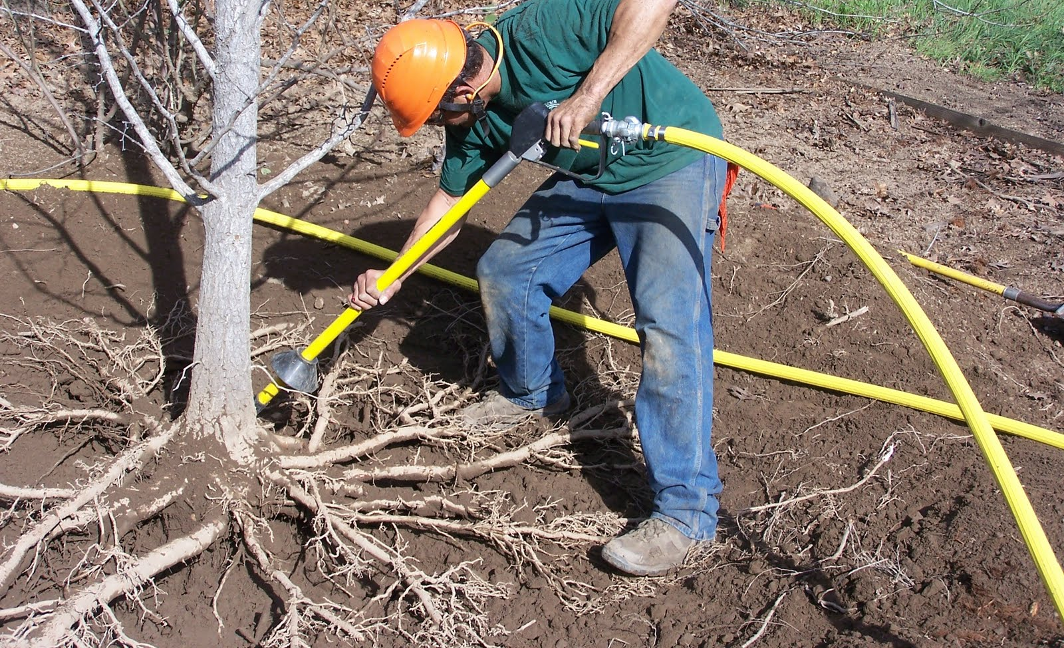
“Deep root watering”
Most tree roots are in the top 12 inches of the soil profile
The needle is inserted into a specific area near the tree and moved around
Is this easier than using a hose and sprinkler?

Slide 34
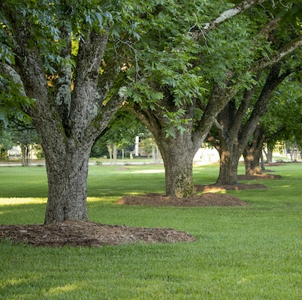
Watering Mature Trees:
Example of how to calculate DBH
Measure the circumference (the distance around) of the trunk, about 4.5 feet from the ground

Slide 35
Example of how to calculate DBH
Measure the circumference (the distance around) of the trunk, about 4.5 feet from the ground
This trunk measures 94.2” in circumference
94.2 inch circumference

Slide 36
Example of how to calculate DBH
94.2 circumference / 3.14 = 30 inches
Measure the circumference (the distance around) of the trunk, about 4.5 feet from the ground
This trunk measures 94.2” in circumference
Divide the circumference by Pi (3.14)
94.2” / 3.14 = 30-inch DBH
30 inches x 10 gallons water = 300 gallons per irrigation application
30 inches x 15 gallons water = 450 gallons
30-inch DBH

Slide 37
Watering Mature Trees
Our CSU publication recommends to water 10-15 gallons per inch of DBH
This is an estimate, as there are so many variables to determine how much water trees need
It’s a good start – some trees may need more or less
Unless you have a meter on your hose or know exactly your sprinkler output, this is difficult to measure – there are conversions online of how to calculate gallons to inches
Some water is better than no water!

Slide 38
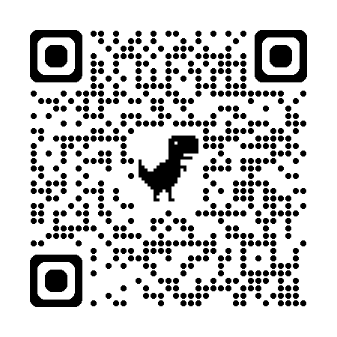
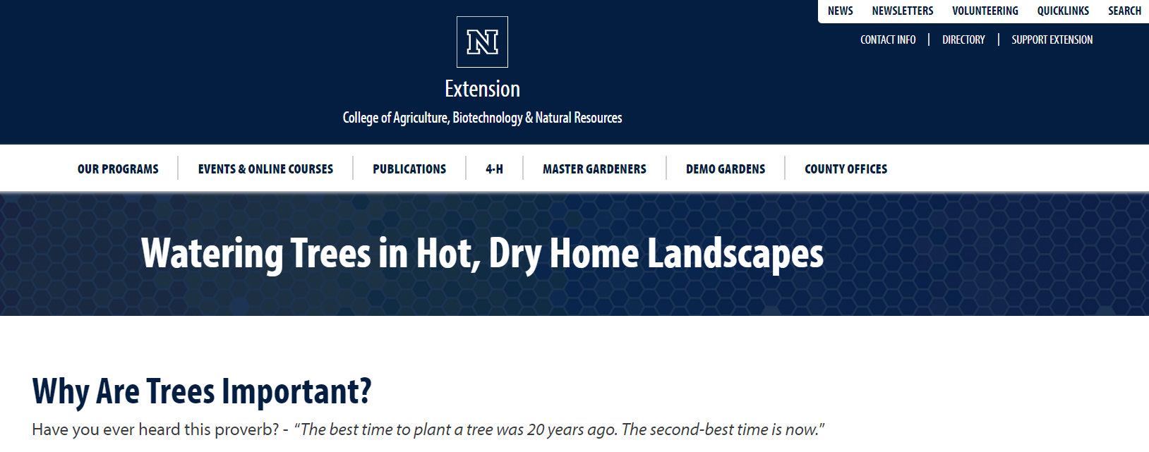
Calculating Drip Irrigation for Trees
Search for “University of Reno drip irrigation for trees”

Slide 39
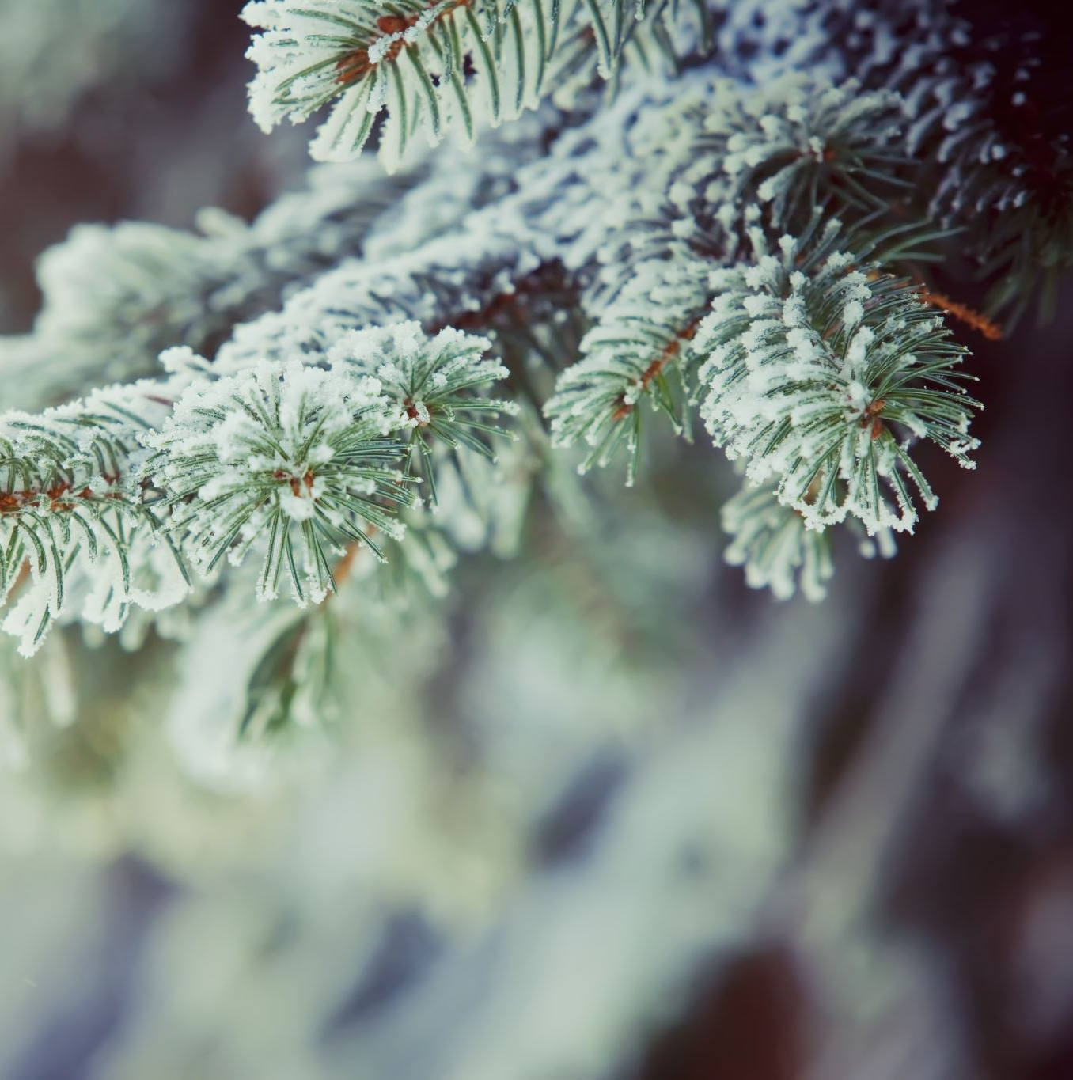
A reminder about fall and winter watering
You need to do this!
Water on days when it’s above 40 degrees, as early in the day as possible
Don’t water if there is snow or ice on the ground near the tree
Use a hose and sprinkler—not your irrigation system!
In fall and winter, trees need one inch of water each month, from snow, rain, or irrigation
CSU Fact Sheet #7.211

Slide 40
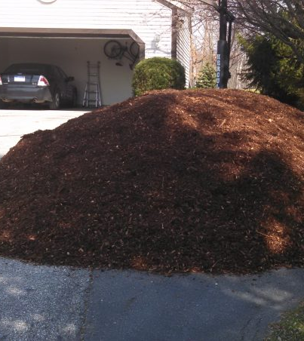
Using mulch effectively
The benefits of mulch are numerous: improvement of soil health, increased soil moisture, decreased weeds, elimination of mechanical injury, and improved plant establishment and growth
There are some disadvantages, such as blowing, expense, refreshment, and potential for fire

Slide 41
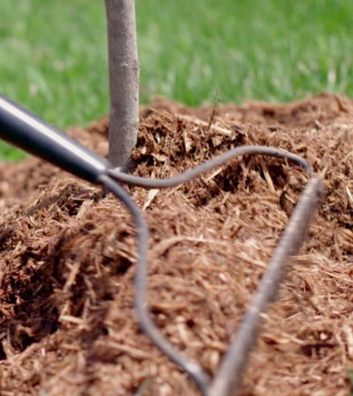
Mulch: improved soil moisture
In general, mulch will significantly reduce the amount of irrigation needed for landscapes and could eliminate the need for supplemental irrigation (with proper plant selection) after establishment
Mulched trees and shrubs will also be able to withstand other environmental stressors, like cold injury

Slide 42
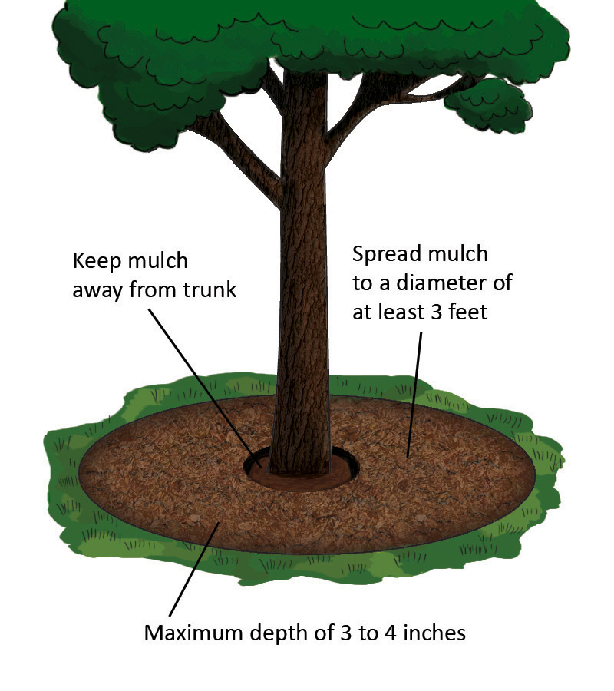
Mulch:
Historically better
Mulch was proven to improve tree growth in 1942—mulched trees grew 62% better than trees grown with bare soil
There have been proven increases in plant height, caliper, leaf size, and flower, fruit and seed production
Living mulch (turf, groundcovers) was found to reduce growth, even worse than bare soil
Maximum depth of 4-5 inches

Slide 43
Mulches for landscapes
Inorganic (rock) | Organic
Less than ½” aggregate | Wood chips
Transfers heat to soil | Buffers soil temperature
Drains surface | Holds Water
Improves infiltration | Can become hydrophobic
Can be messy | Easier to keep in place
4” for weed suppression | 4” for weed suppression
Notes:
Both organic and inorganic mulches are suitable for landscapes—know the difference in how they behave and choose the right mulch for the right place. Note that rock mulch must be gravel—particle size of ½” or less! Also note that regardless of the mulch type, 4” is the “magic depth” for weed suppression. No weed fabric required, and since we’re talking about sustainable gardening, I hope that rolling out a plastic rug into the landscape was already precluded.

Slide 44
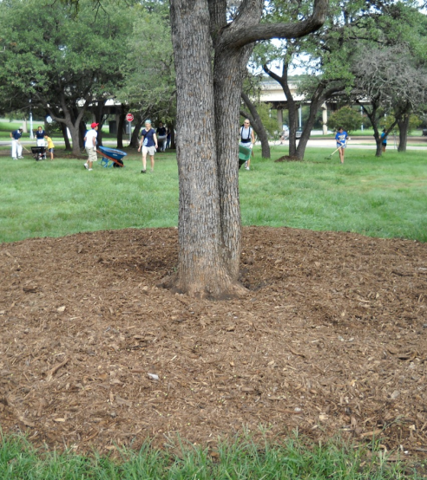
Use wood mulch around trees
Mulch should be 4-5 inches thick, placed on top of the soil surface
Do not cover the top of the root ball of a newly planted tree
Keep mulch 6-8 inches away from the base of established trees
Mulch ring should be a minimum of 2-4 feet wide
Organic mulches are preferred
No landscape fabric under the mulch!

Slide 45
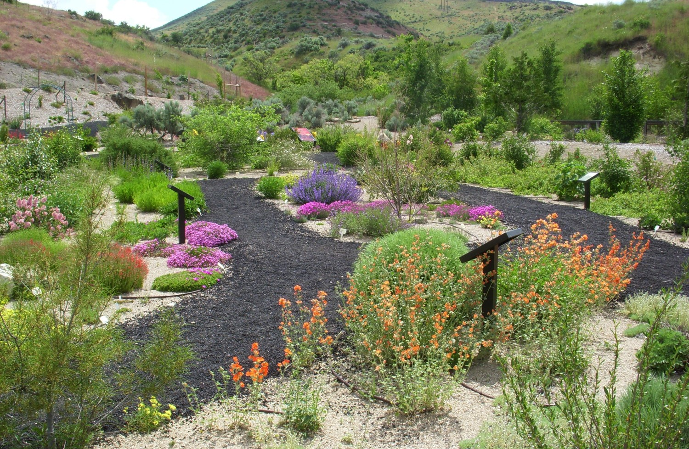
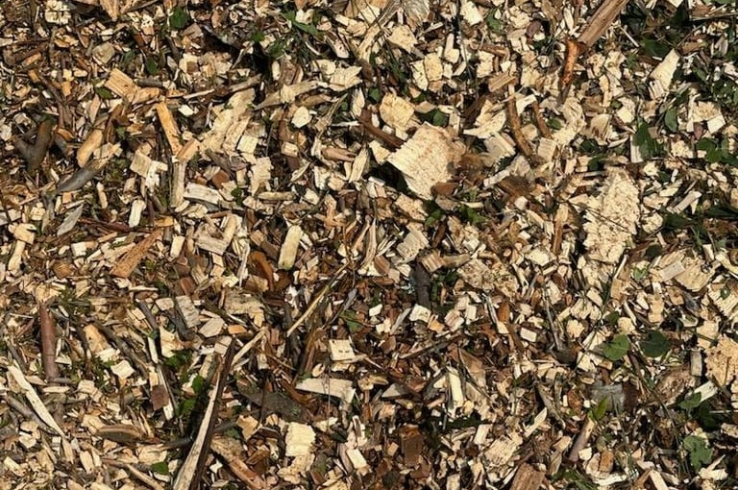

For ornamental beds, use a mulch that works for you
Gravel may be a better choice for natives and waterwise plants
Wood mulch can work in most cases
Find a mulch that works best for you…and use it!

Slide 46
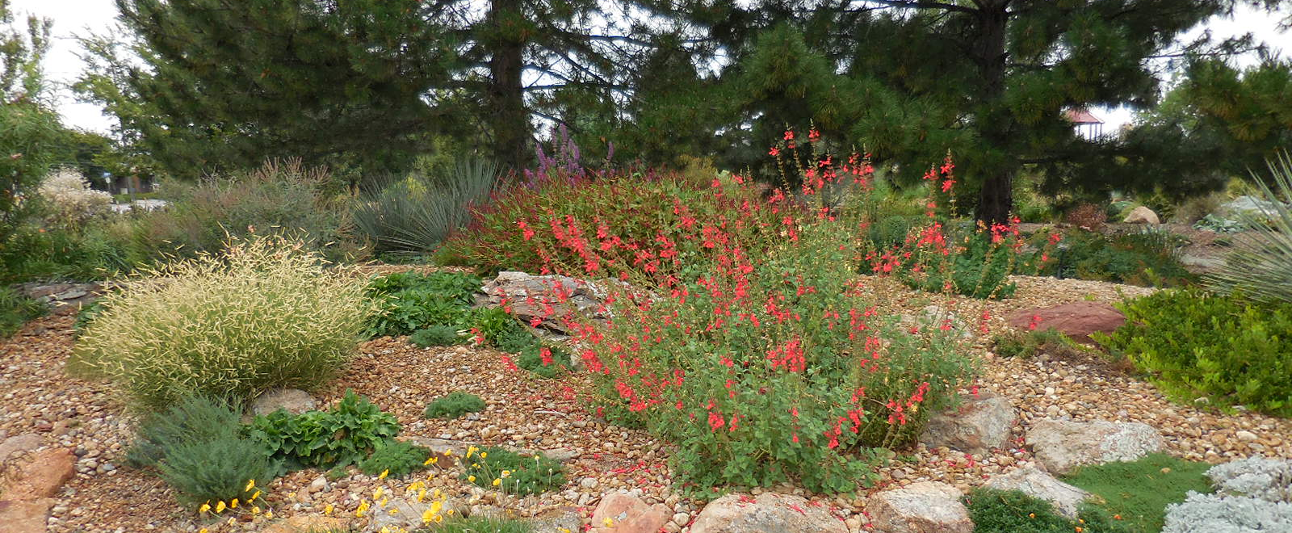
Squeegee, pea gravel, ¾” gravel, rocks

Slide 47

Before doing any conversions!
Stop and assess your landscape
Turf can be problematic for trees
  Competition for water, nutrients, and oxygen
  Herbicides
  Equipment
Trees can be problematic for turf
  Competition for water, nutrients, and oxygen
  Shade
  Surface roots

Slide 48


A look at Alison’s renovation
June 20, 2024
June 21, 2024

Slide 49

June 2024

Slide 50

August 2024

Slide 51

August 2025

Slide 52

Plant selection for waterwise gardens
Local nurseries carry trees, shrubs, perennials, and groundcovers that are waterwise
Zone plants together with similar water and sunlight needs
Natives are well-adapted to use less irrigation

Slide 53

Plant selection for waterwise gardens
Install a variety of plants with different heights, colors and textures
Choose plants for their seasonal interest, including fall color and/or interesting berries, bark or seed heads
Check out water-wise plant lists from various sources

Slide 54

Waterwise plant selection: A few (of my) favorites

Slide 55

Kentucky Coffee Tree
Gymnocladus dioicus
May be male or female
Interesting winter form
Yellow fall color
Mature size (H x W) - 50’ x 40’
Tree shape - Variable
Slow growth rate
Low soil moisture
Plant in full sun, adaptable to wide variety of conditions

Slide 56




Kentucky Coffee Tree
Gymnocladus dioicus
Entire leaf is 2-3’ long and 2’ wide
20-40 leaflets on each leaf
Fruit – large legume, 4-6” long, leathery pod
Seedless male cultivar – ‘Espresso’
Columnar form – ‘Skinny Latte’
Notes:
Early Midwestern settlers used the seeds and pods (which are poisonous in large quantities) as a substitute for real coffee. Native to most of the central-eastern U.S

Slide 57


Hackberry
Celtis occidentalis
55’ tall x 50’ wide
Very adaptable to most soils
Drought tolerant once established
Attractive fruit?
Nipple gall common—only aesthetic; not harmful to the tree
Very commonly available
‘Prairie Sentinel’ is columnar

Slide 58




Autumn Brilliance Serviceberry
Amelanchier x grandiflora ‘Autumn Brilliance’
Plant size– 20’ x 15’ at maturity
Large shrub/small tree
Single stemmed or multi-stemmed
Medium growth rate
Extremely cold hardy
Drought resistant
Tolerates alkaline soil

Slide 59

Serviceberry
Amelanchier species

Slide 60

Prunus besseyi ‘P011S’
Pawnee Buttes® sandcherry
A nativar
Shrubby groundcover
Drought-tolerant and tough as nails
2 feet tall by 6 feet wide

Slide 61

Pawnee Buttes® fall color

Slide 62

Amorpha canescens
Leadplant
A Colorado native
Could be considered a shrub? (woody)
Very drought tolerant
Purple flowers from May to July

Slide 63

Leadplant
Very slow to wake up in spring—don’t give up on it!
Fern-like foliage
Might be a great replacement for Russian sage
Can tolerate most soils

Slide 64

Little bluestem
Schizachyrium scoparium
Warm season
Green to blue-green to blue clumps with great fall color
2 to 3 feet tall
Fluffy, white seed plumes
Native best grown in clay soils
Tolerates light shade
Drought tolerant
Plant up to 7,500 ft. in elevation

Slide 65

Standing Ovation little bluestem

Slide 66

Blaze little bluestem
Not a Plant Select® introduction, but worthy of mention!

Slide 67

Panicum virgatum
Switchgrass
Many ornamental introductions
Up to five feet tall
Some selections have fall color
Warm season—will green up in late spring
May get red or yellow fall color, depending on cultivar
Doesn’t lodge (fall over) in the winter

Slide 68

Switchgrass cultivars
Heavy Metal
Shenandoah
Cloud Nine
Dallas Blues
Northwind
Prairie Sky
Prairie Fire

Slide 69

Thermopsis lupinoides
Golden Candles
Introduced from Plant Select® in 2020
Blooms early – in April and May and great for early pollinators
Very cold hardy (Zone 3)
36 inches tall and 30 inches wide
Showstopper! It’s a “50 mph plant”

Slide 70



Slide 71


Partridge feather
Tanacetum densum subsp. amani
Plush mats of silver foliage – year-round!
Native to Turkey
Full sun; extremely drought tolerant
Height of 4-6” tall and spread to 24”

Slide 72


Partridge feather in spring

Slide 73

Chocolate Flower Berlanderia lyrata
Native wildflower from the Southwest
The flowers exude a rich chocolate aroma in the morning hours
Best with minimal water once established
Heights of 12-20”
Can reseed but difficult to transplant
Cut back in July to keep plants from sprawling and to encourage longer blooming

Slide 74

Moon Carrot
Seseli gummiferum
Blue, lacey, carrot-like foliage that supports HUGE flowers with individual white/pink clusters
Excellent pollinator plant
Full sun and drought tolerant
Wonderful focal plant – plant near a sidewalk or area where it gets attention
Height up to 36 inches tall x 20 inches wide

Slide 75


Slide 76

‘Wee One’ lavender
Lavendula angustifolia ‘Wee One’
A versatile herb and thrives in alkaline soils
English selections are the most cold hardy
Wee One only gets 12” tall and is perfect for rock gardens
Drought tolerant, loves full sun
Spring-planted lavender has better winter survival

Slide 77

Winter Fire® sedum
Petrosedum rupestre 'Rice Creek'
Rustic green, becoming ember-like in the fall
The entire plant is dark burgundy for the coldest months of the winter
Perfect for containers or to plant along pathways and around shrubs
Plant Select® introduction in 2022

Slide 78

Winter Fire® sedum

Slide 79


‘Turquoise Tails’ sedum

Slide 80



Hens and chicks
So much diversity in foliage color with this groundcover!
Very cold hardy
Full sun; water sparingly after establishment
Flowers? Love ‘em or hate ‘em
Onyx

Slide 81

Coneflower
Echinacea purpurea
Very hardy and cold tolerant (to Zone 3)
Full sun
Heat and drought tolerant once established
Attract bees and other pollinators
Freely reseed
Leave spent seedheads for birds

Slide 82


SunMagic Vintage Fuschia
Kismet Raspberry

Slide 83




Coral Bells
Heuchera spp.
Sun to full shade, tolerates dry shade
12” x 12”, flower sits up to 18”
Attractive leaves, lots of variety and colors
Flowers ranging in color from white to amber to purple
Cut flowers periodically to extend bloom period
Rabbit and deer resistant
Easy to grow, adaptable

Slide 84

Questions?
Alison O’Connor
astoven@larimer.org
Free gardening webinars at PlantTalk Colorado
planttalk.org/webinars

