Slide 1




Irrigation Tips & Technology for Your Yard
Scott Curry, PLA, CID, QWEL

Slide 2


Who Am I?
Scott Curry
Assistant Professor at Colorado State University
Licensed Landscape Architect
Certified Irrigation Designer
Qualified Water Efficient Landscaper

Slide 3
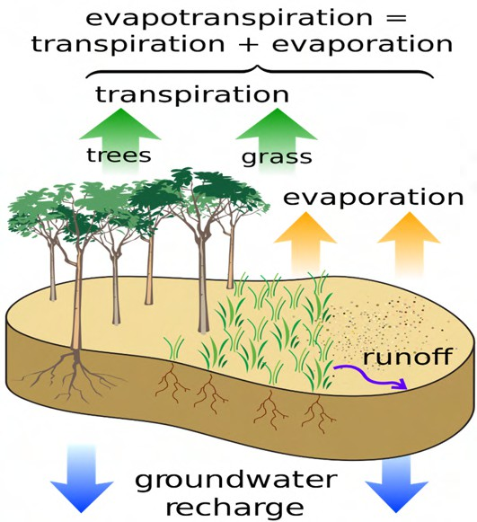
Soil Review – Evapotranspiration
Evapotranspiration or “ET” is the loss of water from vegetation through the combination of soil evaporation and plant transpiration
Things that affect ET are Vegetation Type, Solar Intensity, Temperature, Relative Humidity, and wind speed
Measure in Depth per Time example 1 inch per / Day
ET can be used to estimate water use in landscape and agriculture
More on this later

Slide 4
Soil Moisture Extraction
The force it takes to remove water from the soil is dependent on its water content.
Wet soil water can drain freely due to low internal pressure (Matric potential)
Dry soil water is more difficult to extract
Wilting point generally occurs at 15 bar.
Field capacity generally occurs 24 hrs after saturation. Soil pressure is at around 0.1 bar –
0.33 bar
Optimal plant growth occurs between Field capacity and 1.5 bar.
1 bar = 14.5038 psi
15 bar = 217.557 psi

Slide 5
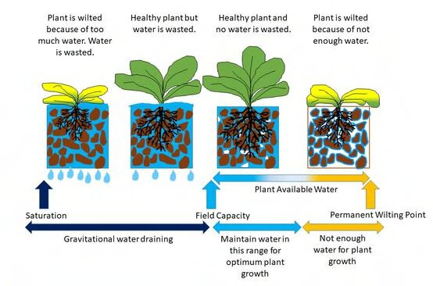
Soil Water Content

Slide 6
Soil Review – Soil Intake Rate
The rate in which water enters the soil. Commonly called Infiltration rate
Very important characteristic for irrigation design and management for preventing run off
Intake rate is directly tied to soil texture there are 5 basic texture classes. Exact texture and exact intake rate of soil are nearly infinite, so the chart below acts as guide.
Commit this table to memory it will come up again
Soil | Texture Categories | Basic Infiltration Rate (in/hr) | Moisture Holding Capacity (in/ft)
Coarse | Sand, Loamy Sand | 1.00 | 0.80
Moderately Coarse | Sandy Loam | 0.50 | 1.10
Medium | Loam, Silt Loam, Silt | 0.40 | 1.40
Moderately Fine | Clay Loam, Silty clay Loam | 0.15 | 1.90
Fine | Sandy Clay, Clay Silty, Clay | 0.10 | 1.70

Slide 7
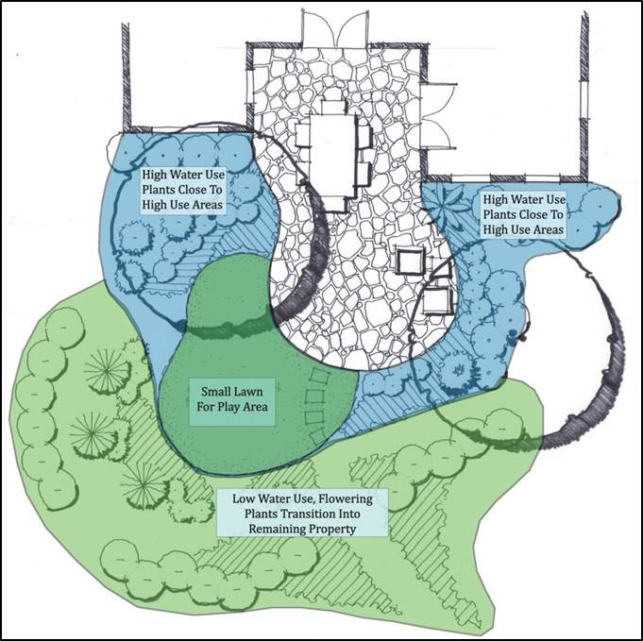
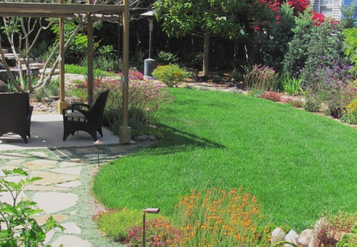
Group Plants According to Water Needs
Create hydrozones
Avoid mixing high- and low-water species
Turf and ornamental beds should not be on the same station/schedule

Slide 8
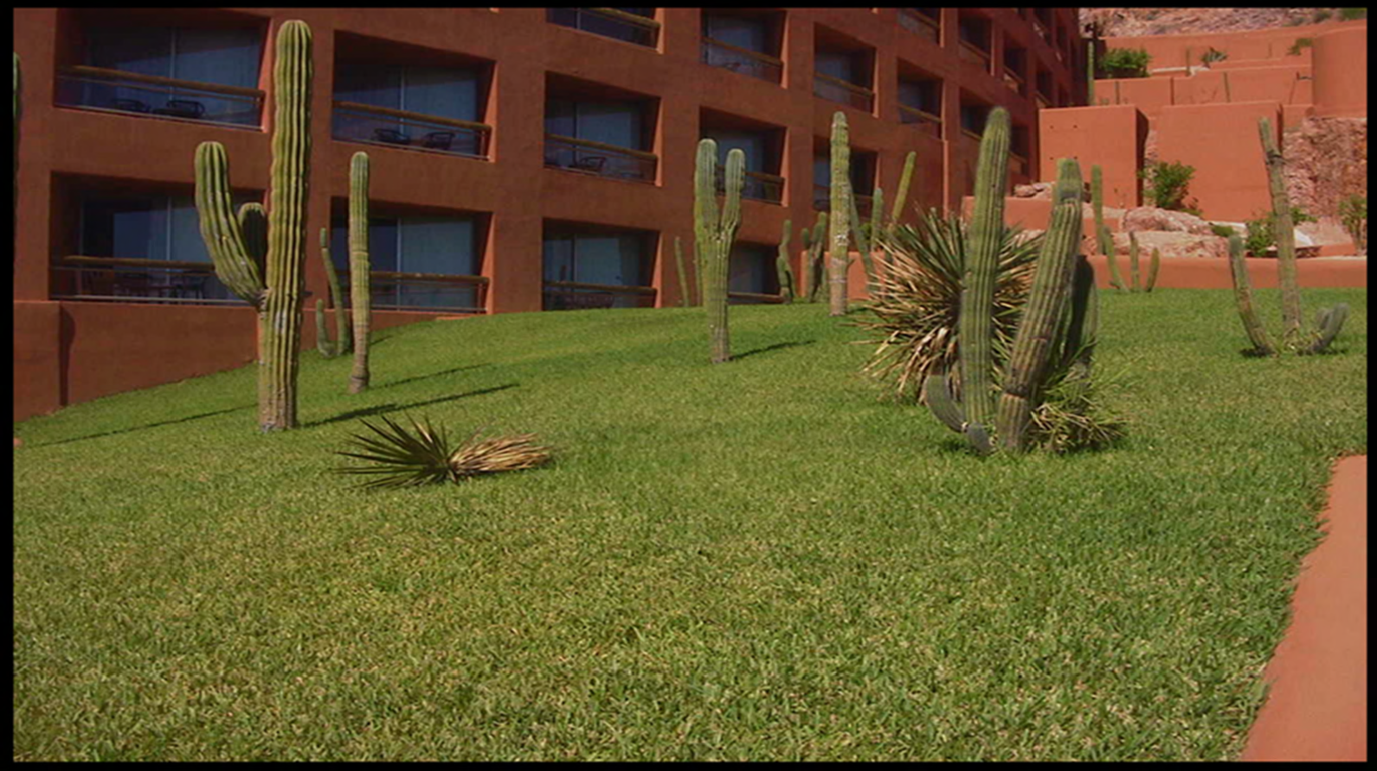
AVOID THIS….
Saguaro cactus
6-10 inches per year
Saguaro cactus
3-6 inches per year
St. Augustinegrass 1-2 inches per week

Slide 9
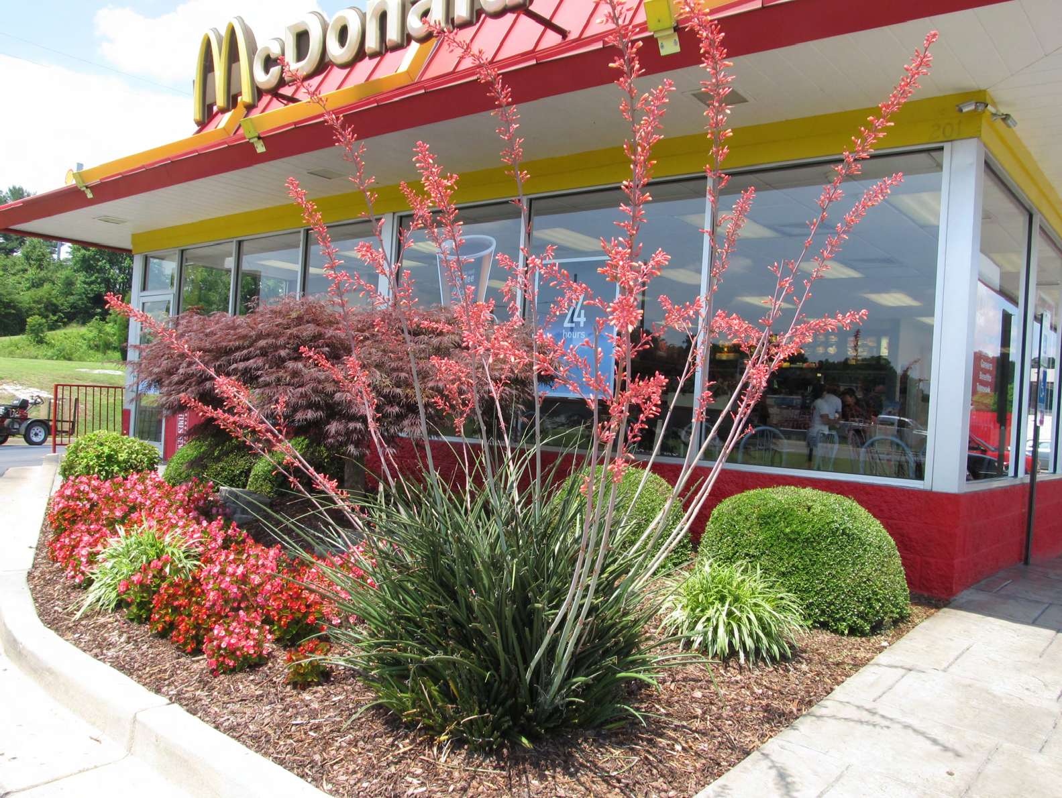
AND THIS….

Slide 10
3 Hydrozone = 3 Irrigation Zones!
Ideally, Irrigation Zones mirror hydro zones to account for microclimates and create the best precision application
Turf Zone
Xeric Plant zone
Moderate Plant Zone
Veggie garden zone (If you have it)
More zones, more control!
More zones also mean more complexity to the system and its management.

Slide 11
Principle of Matched Precipitation Rate
Matched precipitation is all about uniformity of application!
Having match precipitation essentially means that you are applying water in a given spray zone evenly across the entire area of it.
This leads to uniform wetting patterns and absorption across the soil profile
Failure to have MPR in a spray zone will leave area wetter or drier, depending on if the precipitation rate is lower than it should be vs higher
As a best practice DO NOT MIX PRECIPITATION RATES ON NOZZLES
All heads in the zone should have the same or very close to the same precipitation rate.

Slide 12
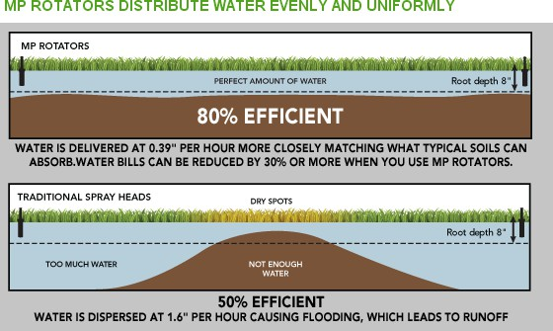
Precipitation Rates: Matched Precipitation Rate (MPR)
Just a reminder form our last class we always want to design with MPR in mind
Even watering is the key to maximum efficiency

Slide 13
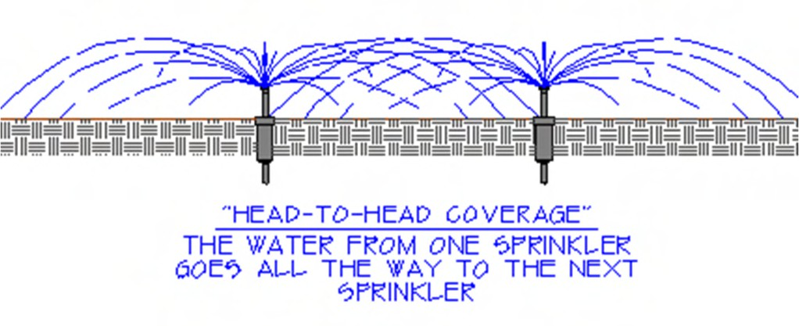
Head Layout
When you are laying out heads typically you want to have a “head to head” condition. This is essential for turf grass, but looser coverage can be used on native seed or planter beds.
You never want an “arch-to-arch” condition is leads to poor uniformity of irrigation
Let's look at a few examples on the board.

Slide 14
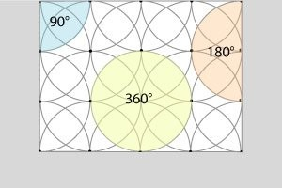
Head Layout: Head to Head!

Slide 15

How do We apply this stuff?

Slide 16
Irrigation Auditing
Auditing is the practice of evaluating how efficient your irrigation system is, typically represented in percentage, i.e., (70%)
Import consideration for good efficiency
All Nozzles are the same brand and series (MPR, MP Rotator, R-Van)
All spray bodies are the same brand and are pressure-regulated to match the nozzles peak performance range (More on this later)
All heads are level and nozzles are clear of debris
Heads are spraying heads to head
There are not too many heads on one zone
Heads are receiving adequate pressure e

Slide 17
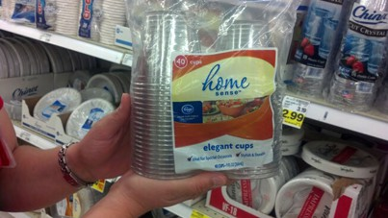
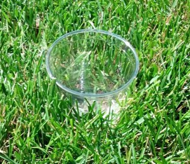
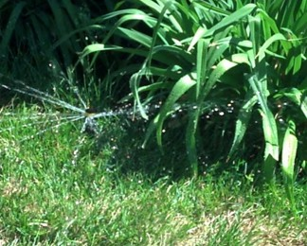
At home Auditing Steps
Step 1
Gather 12 identical containers for collecting water. These can be tuna or cat food cans, plastic cups, rain gauges, etc. They must be the same type to collect water evenly and sit level in the lawn.
Step 2
Working in one irrigation zone, randomly place the cups in the lawn. Put some on green areas
and some on brown areas. Make sure the containers are level. Avoid placing containers next to sprinkler heads – keeping them a few feet away.
Step 3
Let the irrigation system run through a normal cycle. Or run the system for 15-20 minutes while watching the sprinklers run. Look for crooked, low, plugged, or blocked heads.

Slide 18
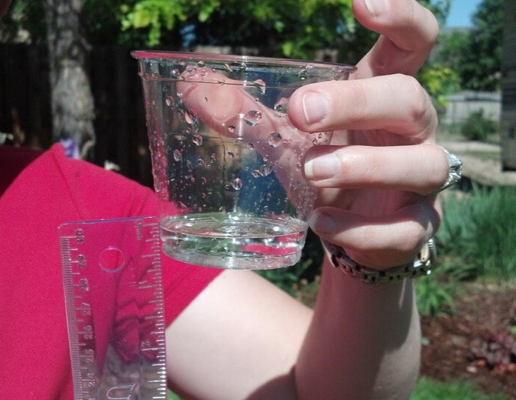
At home Auditing Steps
Step 4
Measure the depth of the water in each container with a ruler. Write down each number, along with a note if the lawn is healthy or brown. Measure to 1/10″ if possible.
Step 5
Do some simple math to get the average depth of water applied in the green turf areas and the brown areas. While it may seem insignificant, keep in mind that a green area that received 0.2″ of water versus a brown area with 0.1″ is getting TWICE as much water every time you irrigate!

Slide 19
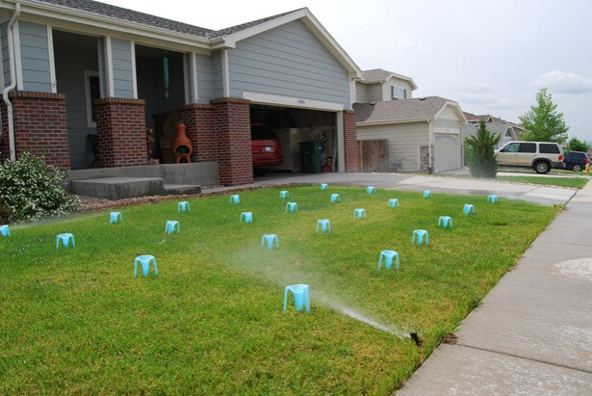
Professional Auditing
Established DUlq as an industry-accepted efficiency metric
Confirms pressure at the point of connection as well as at the heads
Creates notes on issues that were present at the time of inspection that can then be fixed. Some
services will fix issues as part of the audit.
Your Efficiency will be presented as a percentage
Below 50% would indicate the system should be replaced or needs serious work. Many systems fall into this category!
70%+ would be a high-performing system
80%-95% is realistically only possible with drip irrigation

Slide 20
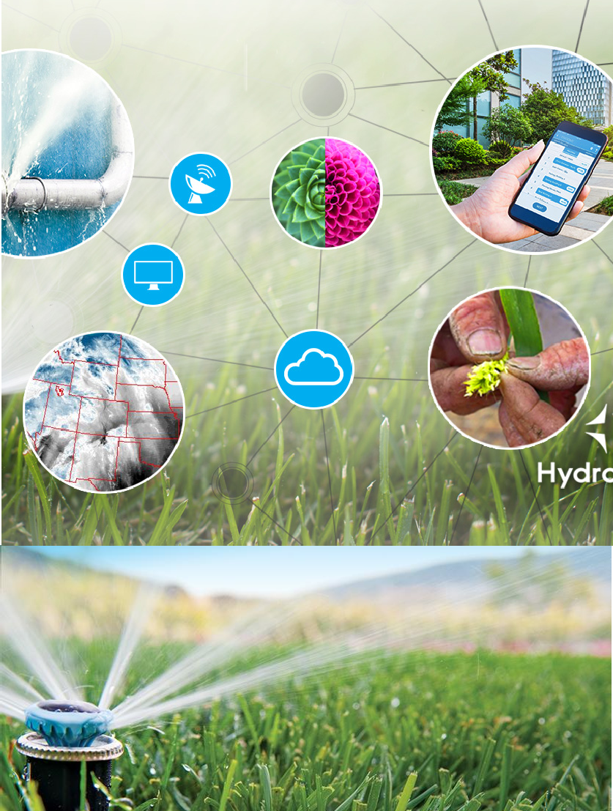
Irrigation Technology

Slide 21
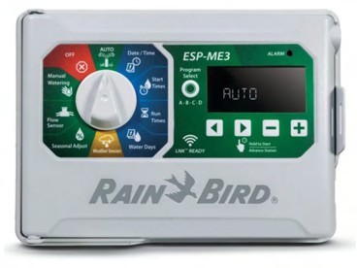
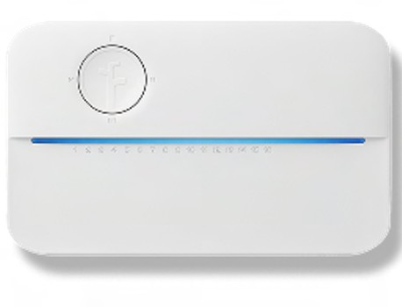

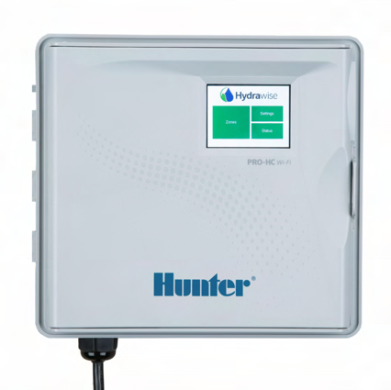
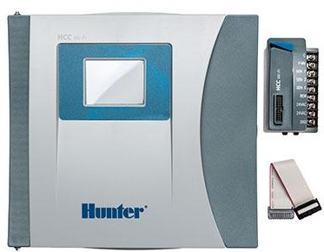
Smart Irrigation Controllers
New Generation of controllers does not a traditional timer
Built-in weather tracking, rain and freeze delays
Use ET to adjust run times
Wi-Fi enables an app controller
Easy replacement for traditional timer
Great first step to a stronger irrigation system management
•

Slide 22



Central Controls
/ App Controls
Hunter Hydrawise
Rachio Hub
Nice way to get updates and manage irrigation
Send a notification if something is wrong. Best results with Master Valve and Flow Sensor
Alerts if irrigation is skipped due to weather

Slide 23
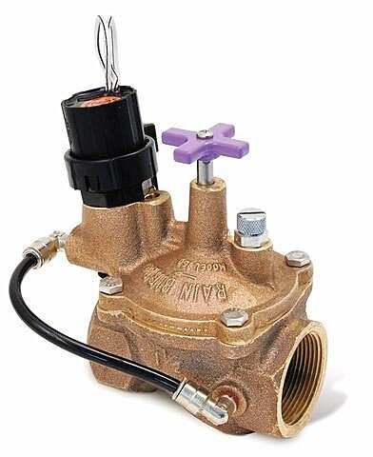
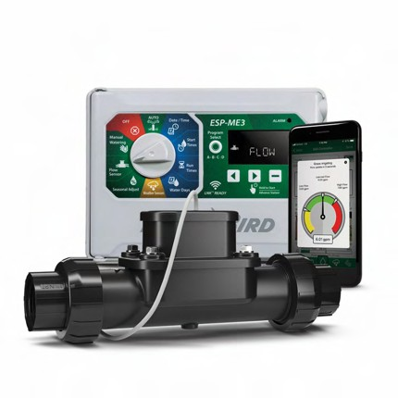
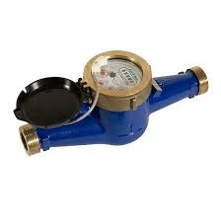
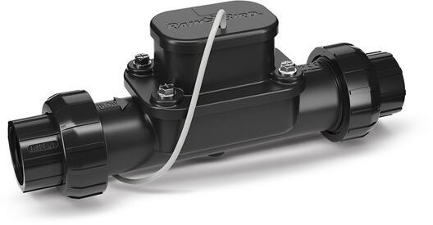
Flow Sensors & Master Valves
Best defense against Leaks and breaks
Learn Flow capabilities
Can tell you a lot about underflow and overflow
One of the things that makes a smart controller smart!

Slide 24
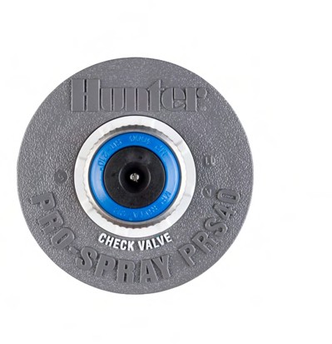
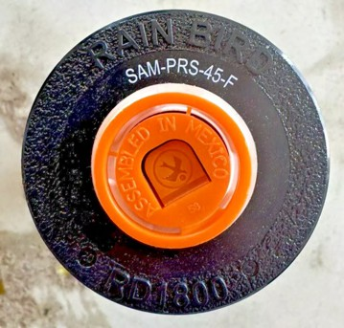
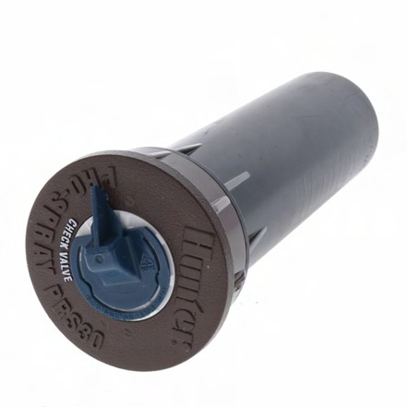
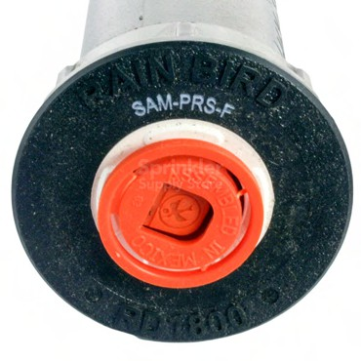
Pressure Regulated Spray bodies
Now required by state Law for new installation
Helps the nozzle operate at peak efficiency
Look at the top of the head and look for “PRS” on the top of the head
Different Nozzles need different pressure regulation

Slide 25
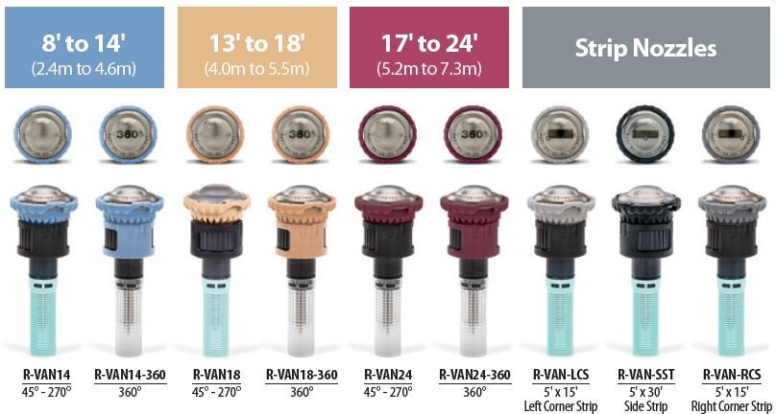
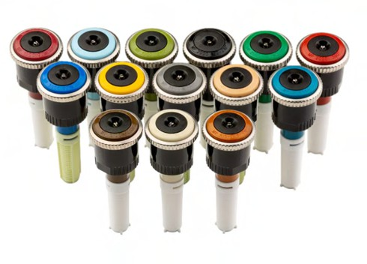
Rotary Nozzles
Most efficient nozzles available up to 80%
Much lower precipitation rates, you need to run these a lot longer to get water down !
Needs more pressure to operate properly
Rain Bird R-Van = 45 PSI Pressure Regulated
Hunter MP-Rotator = 40 PSI Pressure Regulated

Slide 26
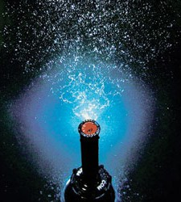
Toro Precision Nozzles
Lower precipitation rate than traditional MPR Nozzles
More efficient spray pattern up to 75% Efficiency
30 PSI pressure regulated
Easy replacement for standard nozzles
Has many unique angles and spray lengths to fit your yard

Slide 27
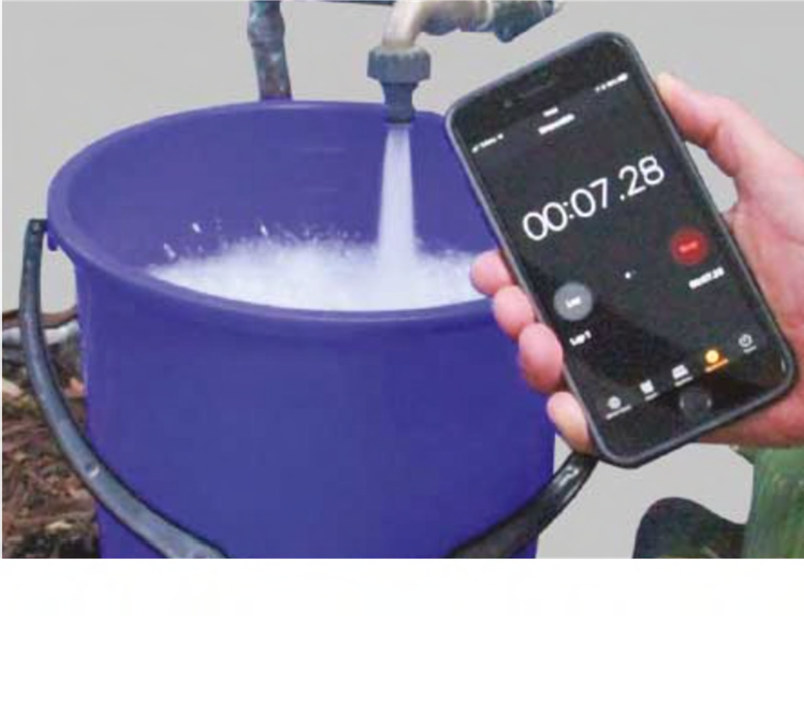
Hand Watering “Bucket Test”
Simple concept: How long does it take to fill a 5-gallon bucket? To understand gallons per minute
Example 5 gallons take 30 second = 10 gallons per minute
Do this 3 times and take the average of the times for the best results
This will help you better understand how much you should hand-water or hose sprinkler water

Slide 28
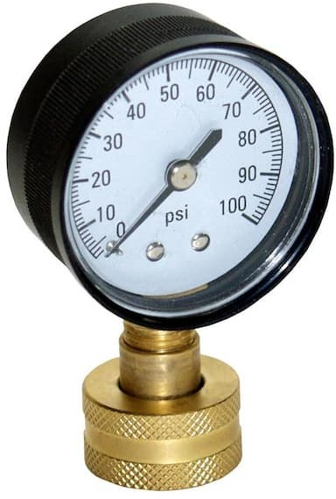
Check Your Pressure!
Buy a hose bib pressure gauge to check your pressure!
Low pressure can result in poor performance of irrigation systems
High pressure can cause additional wear and tear on system components
50-70 psi is a great range to be in
Over 90 psi could be an issue
Under 37 psi is when to worry

Slide 29
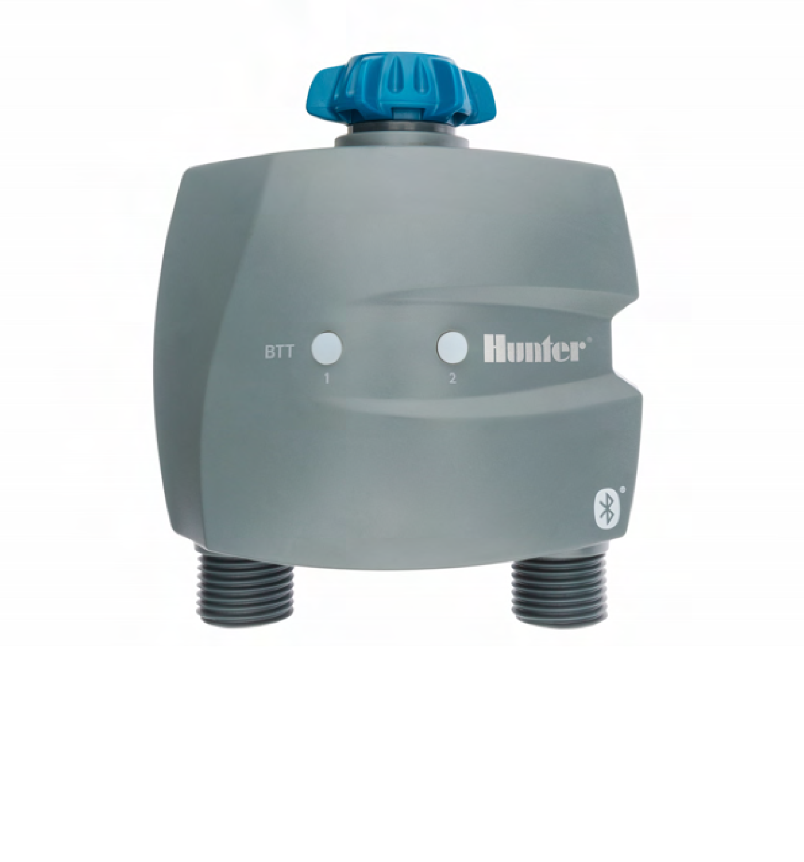
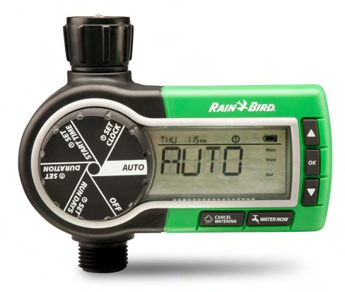
Hose Timers
Hose timers can be set manually or are Bluetooth-enabled
Very helpful for hose-connected sprinklers. Helps manage zone run time, like an in-ground irrigation system
Can connect point source drip to these as well

Slide 30
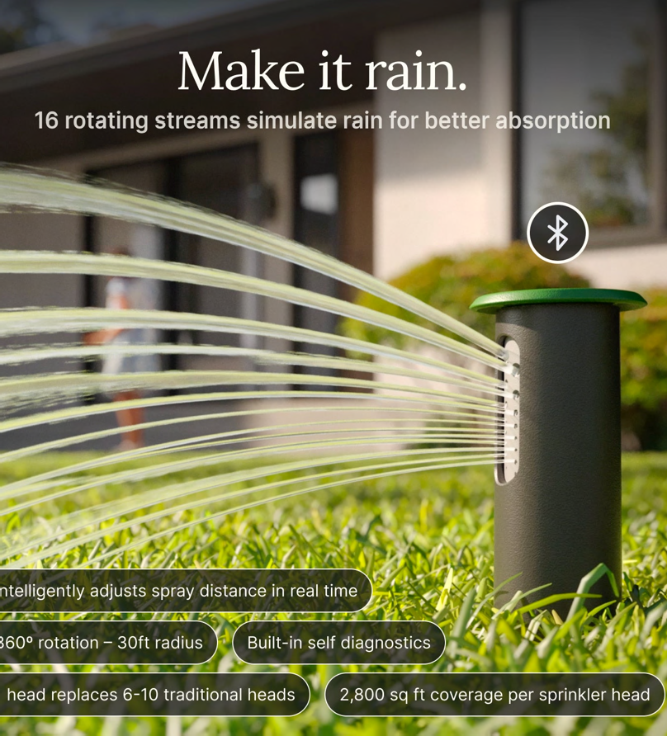
Irrigreen
Single Head system that adjusts precipitation rate and throw based on the shape of the lawn it’s watering
Minimizes material inputs, but the system is totally proprietary
Check out their website for a demo video! It’s super cool
I cannot verify their claims about 50% less water use that is a bold statement with a lot of assumptions

Slide 31
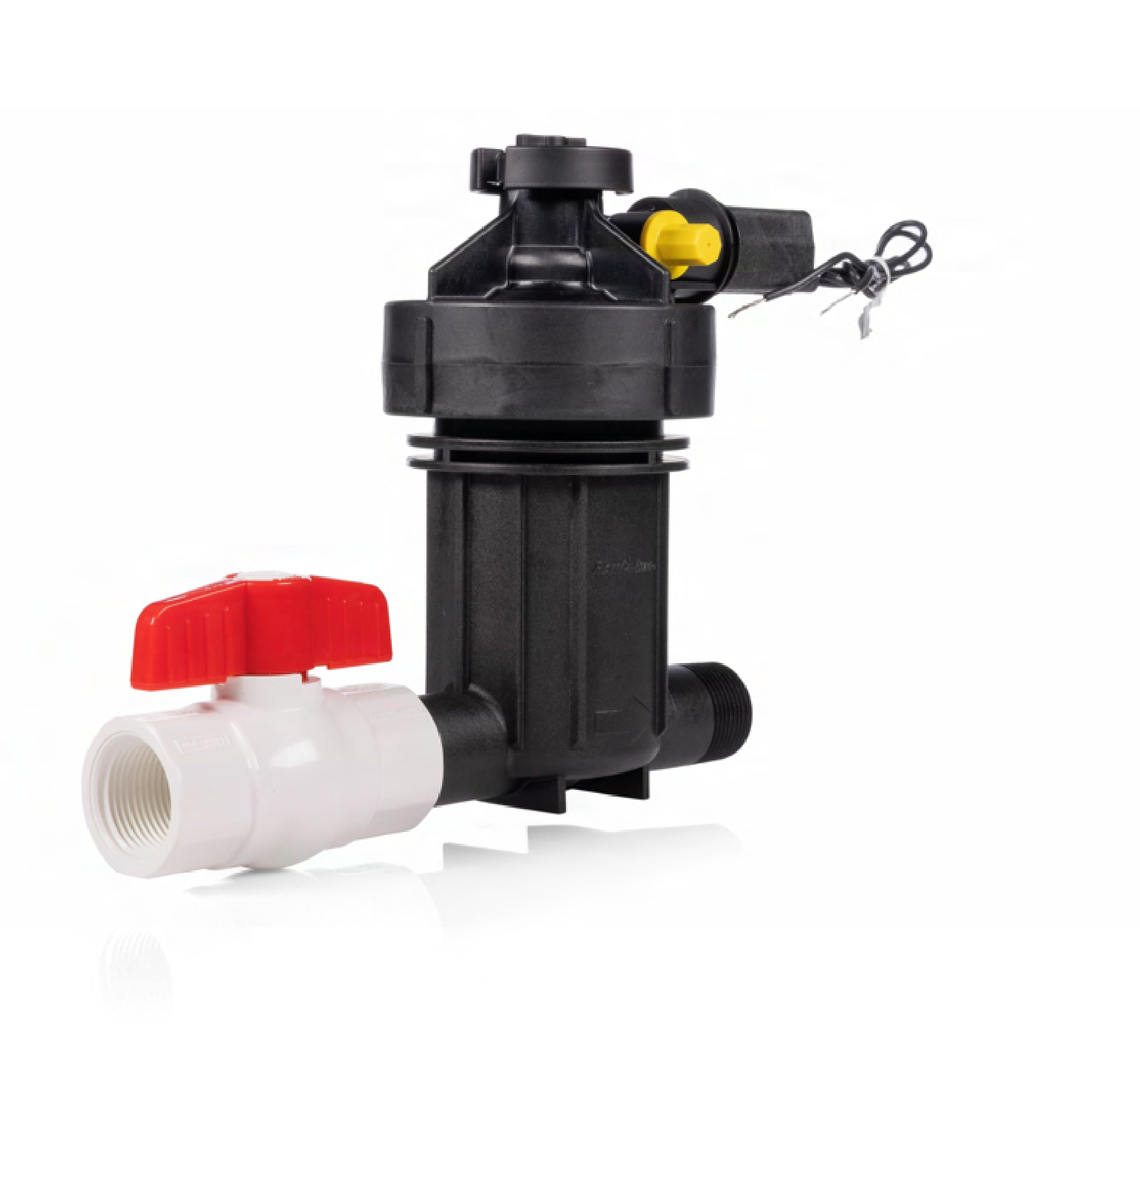
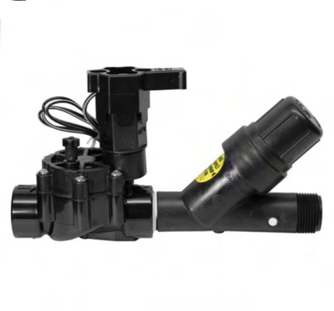
Drip Conversions
Any irrigation valve can be converted to a drip by adding a pressure-regulating filter
New all-in-one drip kits can replace an entire assembly
Simply run the poly pipe on the surface after the valve is set up. Under mulch is my recommended way of doing this.

Slide 32
Where can I buy these things?
In Store
Site One Landscape Supply
CPS Distributors
Denver Brass and Copper
Home Depot for the Basics only!
Online
Drip Depot
Big Irrigation
Sprinkler Supply Store
Even Amazon, if you know exactly what you are looking for!

Slide 33


CONSIDER CONVERTING TO A “COLORADOSCAPE”

Slide 34
THANK YOU!
Scott Curry, PLA, CID, QWEL
Contact: S.curry@colostate.edu

Slide 35
Questions?!

