Slide 1
Know Your Yard: Your Rights & Landscaping Rules
Darren Nowels
Senior Water Efficiency Planner, Northern Water

Slide 2
Where does our water come from?

Slide 3
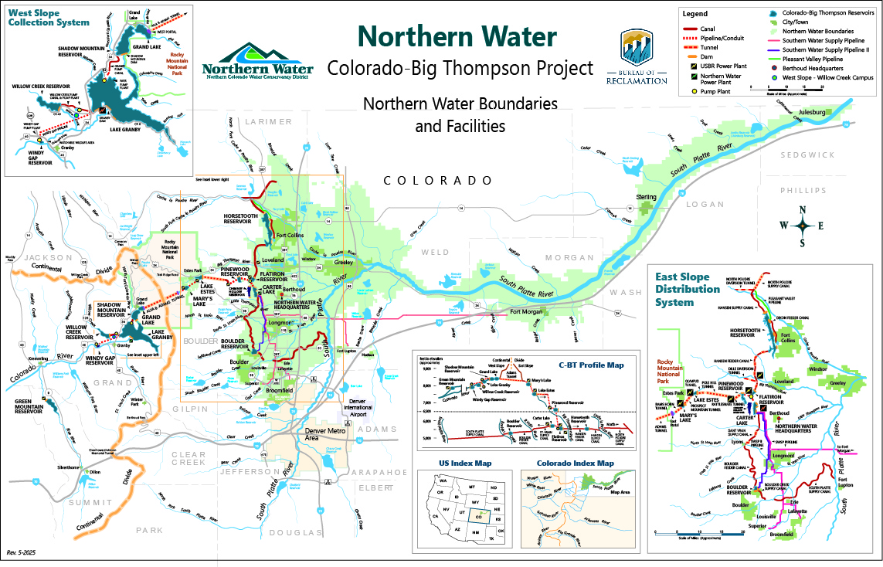
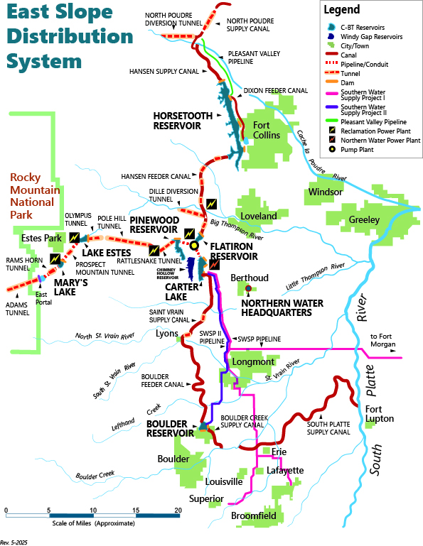

Slide 4
How is Colorado’s water used?

Slide 5
Water Usage in Colorado
Source: 2023 Colorado Water Plan

Slide 6
Colorado-Big Thompson Project Water Usage

Slide 7
Why is it important to conserve water on our landscape?

Slide 8
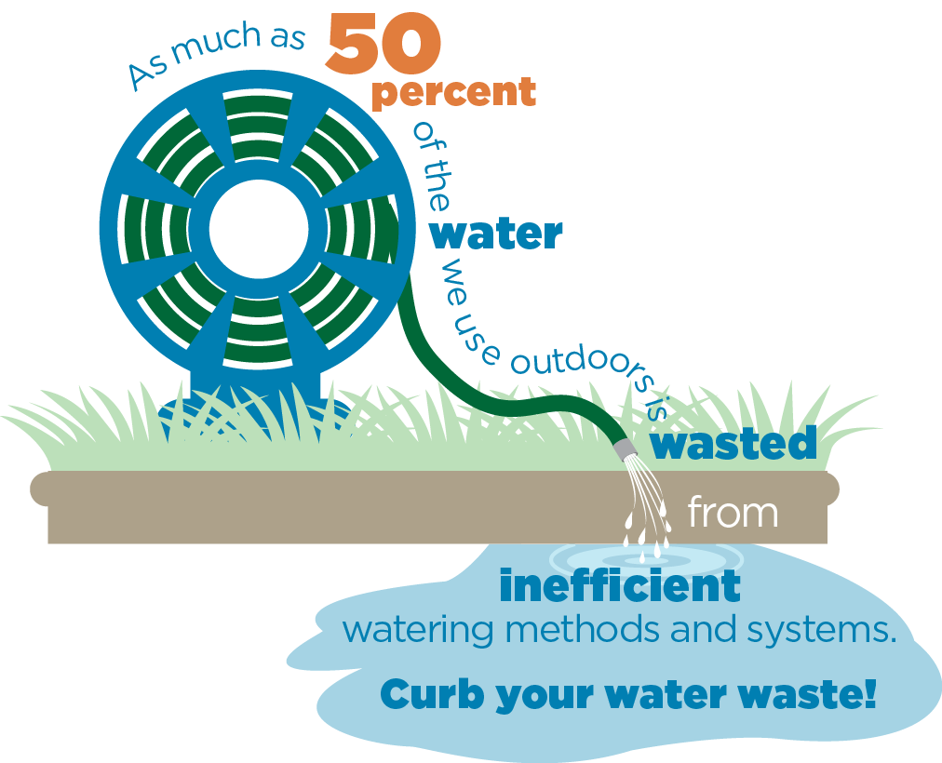
40-60% of Municipal Water is Used on the Landscape
Source: U.S. EPA Water Sense

Slide 9
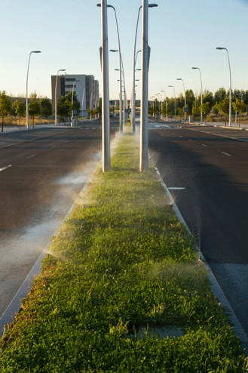
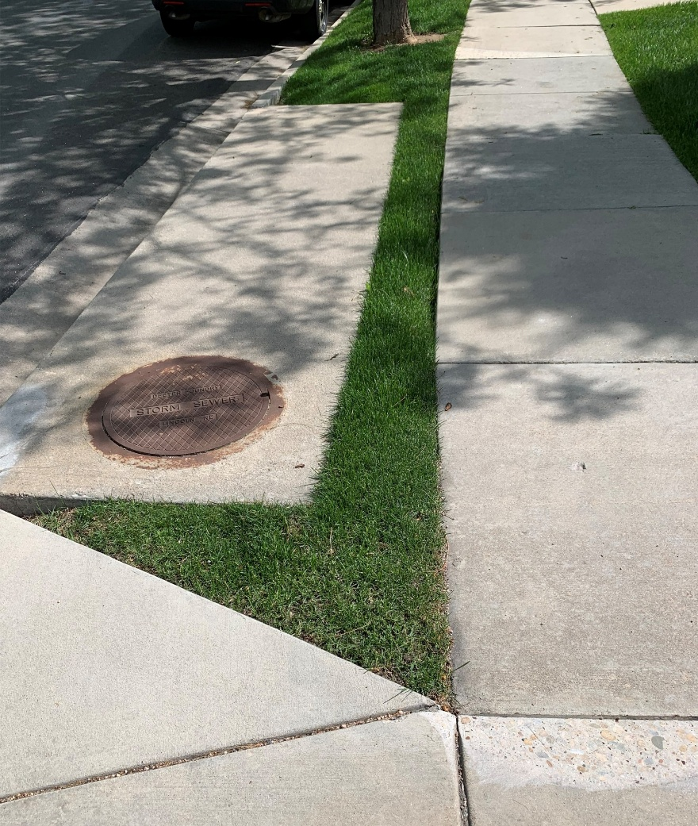
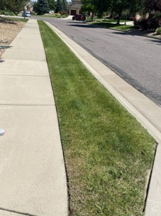
Non-Functional Turf
No Recreation Value
No Practical Uses
Strictly Ornamental

Slide 10
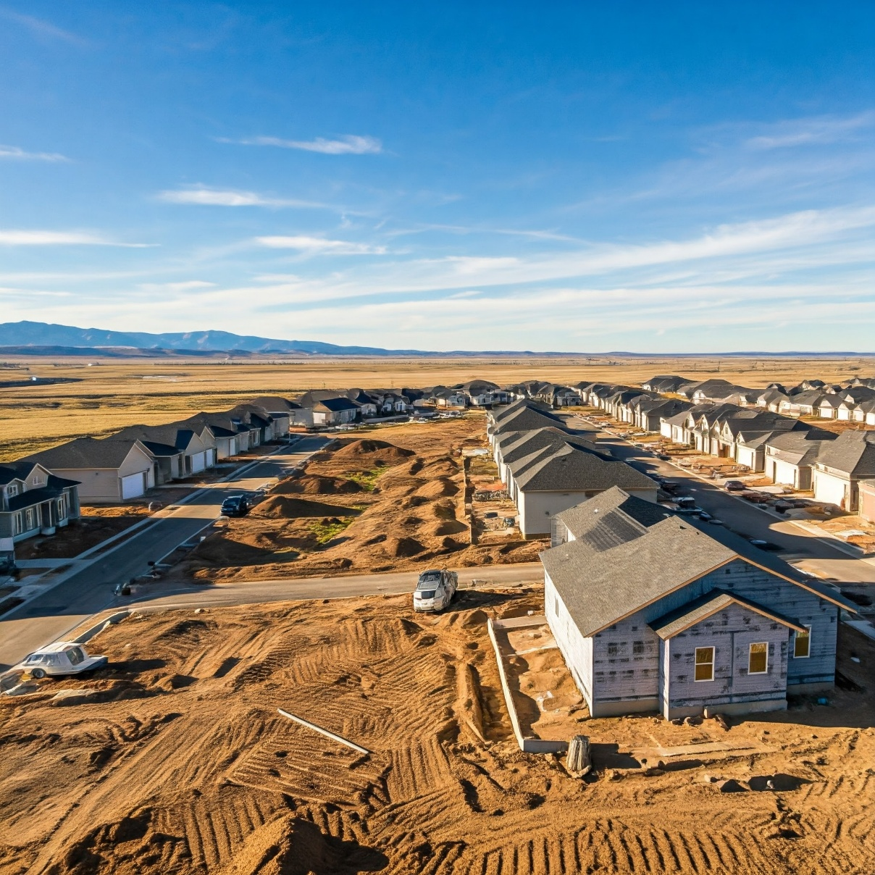
Rapid Growth Drives Need to Conserve
District Population Grew by 32% (2010-2020)
Still growing (2020-2023)
  4 of top 10 fastest growing cities in CO
    Windsor leads with 23%
    Erie, Loveland, Greeley
  9 of top 10 growing communities
    Timnath, 54%
    Ault, 40.8%
    Severance, 40.6%
More businesses, more jobs, more homes
Leading to agriculture dry-up
  Land moving to residential developments
  Water moving to municipal use
​

Slide 11
State Legislation Designed to Support Landscape Water Efficiency

Slide 12
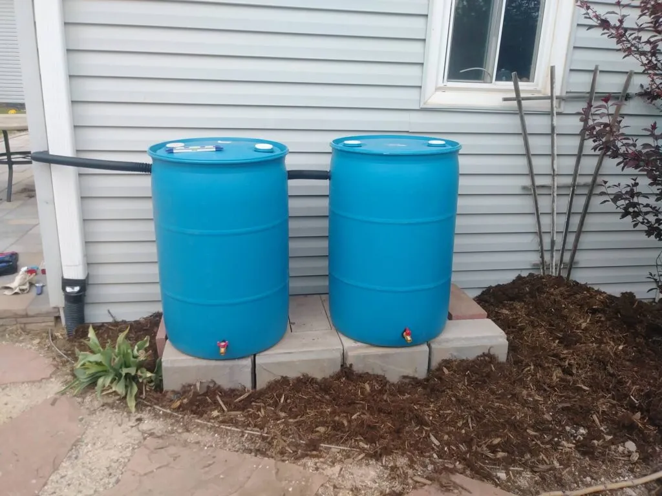
Residential Precipitation Collection (HB16-1005)
Maximum of 2 rain barrels
No more than 110 gallons total
Collected from residential rooftop
Must be used on the property
Outdoor use only
Source: Colorado Water Center

Slide 13


Rain Barrel Resources from Colorado Water Center
Resources List
Rain Barrel Installation Guide

Slide 14
Water-wise Landscaping in HOAs (SB23-178)
What HOAs CAN’T do:
Prohibit the use of artificial turf in backyards
Require hardscape or turf grass on more than 20% of landscape
Prohibit vegetable gardens in front, back, or side yards
Notes:
an association shall not prohibit any of the following:
(i) (I) (A) The use of xeriscape, nonvegetative turf grass, or drought-tolerant vegetative landscapes to provide ground covering to property for which a unit owner is responsible, including a limited common element or property owned by the unit owner. Associations may adopt and enforce design or aesthetic guidelines or rules that apply to nonvegetative turf grass and drought-tolerant vegetative landscapes or regulate the type, number, and placement of drought-tolerant plantings and hardscapes that may be installed on a unit owner's property or on a limited common element or other property for which the unit owner is responsible. An association may restrict the installation of nonvegetative turf grass to rear yard locations only. THIS SUBSECTION (1)(i)(I)(A), AS AMENDED BY SENATE BILL 23-178, ENACTED IN 2023, APPLIES ONLY TO A UNIT THAT IS A SINGLE-FAMILY HOME THAT SHARES ONE OR MORE WALLS WITH ANOTHER UNIT AND DOES NOT APPLY TO A UNIT THAT IS A DETACHED SINGLE-FAMILY HOME.
(i.5) (I) THE USE OF XERISCAPE, NONVEGETATIVE TURF GRASS, OR DROUGHT-TOLERANT ORNONVEGETATIVE LANDSCAPES TO PROVIDE GROUND COVERING TO PROPERTY FOR WHICH A UNIT OWNER IS RESPONSIBLE, INCLUDING A LIMITED COMMON ELEMENT OR PROPERTY OWNED BY THE UNIT OWNER AND ANY RIGHT-OF-WAY OR TREE LAWN THAT IS THE UNIT OWNER'S RESPONSIBILITY TO MAINTAIN. ASSOCIATIONS MAY ADOPT AND ENFORCE DESIGN OR AESTHETIC GUIDELINES OR RULES THAT APPLY TO DROUGHT-TOLERANT VEGETATIVE OR NONVEGETATIVE LANDSCAPES OR TO VEGETABLE GARDENS OR THAT REGULATE THE TYPE, NUMBER, AND PLACEMENT OF DROUGHT-TOLERANT PLANTINGS AND HARDSCAPES THAT MAY BE INSTALLED ON PROPERTY THAT IS SUBJECT TO THE GUIDELINES OR RULES; EXCEPT THAT THE GUIDELINES OR RULES MUST:
(A) NOT PROHIBIT THE USE OF NONVEGETATIVE TURF GRASS IN THE BACKYARD OF A UNIT OWNER'S PROPERTY;
(B) NOT UNREASONABLY REQUIRE THE USE OF HARDSCAPE ON MORE THAN TWENTY PERCENT OF THE LANDSCAPING AREA OF A UNIT OWNER'S PROPERTY;
(C) ALLOW A UNIT OWNER AN OPTION THAT CONSISTS OF AT LEAST EIGHTY PERCENT DROUGHT-TOLERANT PLANTINGS; AND PAGE 2-SENATE BILL 23-178
(D) NOT PROHIBIT VEGETABLE GARDENS IN THE FRONT, BACK, OR SIDE YARD OF A UNIT OWNER'S PROPERTY. As USED IN THIS SUBSECTION (1)(i.5), "VEGETABLE GARDEN" MEANS A PLOT OF GROUND OR AN ELEVATED SOIL BED IN WHICH POLLINATOR PLANTS, FLOWERS, OR VEGETABLES OR HERBS, FRUITS, LEAFY GREENS, OR OTHER EDIBLE PLANTS ARE CULTIVATED.
…
(II) FOR THE PURPOSES OF THIS SUBSECTION (1)(i.5), EACH ASSOCIATION SHALL SELECT AT LEAST THREE PREPLANNED WATER-WISE GARDEN DESIGNS THAT ARE PREAPPROVED FOR INSTALLATION IN FRONT YARDS WITHIN THE COMMON INTEREST COMMUNITY. To BE PREAPPROVED, A GARDEN DESIGN MUST ADHERE TO THE PRINCIPLES OF WATER-WISE LANDSCAPING, AS DEFINED IN SECTION 37-60-135 (2)(1), WHICH EMPHASIZE DROUGHT-TOLERANT AND NATIVE PLANTS, OR BE PART OF A WATER CONSERVATION PROGRAM OPERATED BY A LOCAL WATER PROVIDER. EACH GARDEN DESIGN MAY BE SELECTED FROM THE COLORADO STATE UNIVERSITY EXTENSION PLANT SELECT ORGANIZATION'S "DOWNLOADABLE DESIGNS" LIST OR FROM A MUNICIPALITY, UTILITY, OR OTHER ENTITY THAT CREATES SUCH GARDEN DESIGNS. AN ASSOCIATION SHALL CONSIDER A UNIT OWNER'S USE OF ONE OF THE GARDEN DESIGNS SELECTED BY THE ASSOCIATION TO BE PREAPPROVED AS COMPLYING WITH THE ASSOCIATION'S AESTHETIC GUIDELINES AND SHALL ALLOW A UNIT OWNER TO USE REASONABLE SUBSTITUTE PLANTS WHEN A PLANT IN A DESIGN ISN'T AVAILABLE. EACH ASSOCIATION SHALL POST ON ITS PUBLIC WEBSITE, IF ANY, INFORMATION CONCERNING PREAPPROVALS OF GARDEN DESIGNS.

Slide 15
Water-wise Landscaping in HOAs (SB23-178)
Also HOAs:
CAN enforce design or aesthetic guidelines, including plant lists
MUST provide 3 pre-approved waterwise designs
MUST allow at least 80% of landscape to be drought-tolerant plantings
Notes:
an association shall not prohibit any of the following:
(i) (I) (A) The use of xeriscape, nonvegetative turf grass, or drought-tolerant vegetative landscapes to provide ground covering to property for which a unit owner is responsible, including a limited common element or property owned by the unit owner. Associations may adopt and enforce design or aesthetic guidelines or rules that apply to nonvegetative turf grass and drought-tolerant vegetative landscapes or regulate the type, number, and placement of drought-tolerant plantings and hardscapes that may be installed on a unit owner's property or on a limited common element or other property for which the unit owner is responsible. An association may restrict the installation of nonvegetative turf grass to rear yard locations only. THIS SUBSECTION (1)(i)(I)(A), AS AMENDED BY SENATE BILL 23-178, ENACTED IN 2023, APPLIES ONLY TO A UNIT THAT IS A SINGLE-FAMILY HOME THAT SHARES ONE OR MORE WALLS WITH ANOTHER UNIT AND DOES NOT APPLY TO A UNIT THAT IS A DETACHED SINGLE-FAMILY HOME.
(i.5) (I) THE USE OF XERISCAPE, NONVEGETATIVE TURF GRASS, OR DROUGHT-TOLERANT ORNONVEGETATIVE LANDSCAPES TO PROVIDE GROUND COVERING TO PROPERTY FOR WHICH A UNIT OWNER IS RESPONSIBLE, INCLUDING A LIMITED COMMON ELEMENT OR PROPERTY OWNED BY THE UNIT OWNER AND ANY RIGHT-OF-WAY OR TREE LAWN THAT IS THE UNIT OWNER'S RESPONSIBILITY TO MAINTAIN. ASSOCIATIONS MAY ADOPT AND ENFORCE DESIGN OR AESTHETIC GUIDELINES OR RULES THAT APPLY TO DROUGHT-TOLERANT VEGETATIVE OR NONVEGETATIVE LANDSCAPES OR TO VEGETABLE GARDENS OR THAT REGULATE THE TYPE, NUMBER, AND PLACEMENT OF DROUGHT-TOLERANT PLANTINGS AND HARDSCAPES THAT MAY BE INSTALLED ON PROPERTY THAT IS SUBJECT TO THE GUIDELINES OR RULES; EXCEPT THAT THE GUIDELINES OR RULES MUST:
(A) NOT PROHIBIT THE USE OF NONVEGETATIVE TURF GRASS IN THE BACKYARD OF A UNIT OWNER'S PROPERTY;
(B) NOT UNREASONABLY REQUIRE THE USE OF HARDSCAPE ON MORE THAN TWENTY PERCENT OF THE LANDSCAPING AREA OF A UNIT OWNER'S PROPERTY;
(C) ALLOW A UNIT OWNER AN OPTION THAT CONSISTS OF AT LEAST EIGHTY PERCENT DROUGHT-TOLERANT PLANTINGS; AND
(D) NOT PROHIBIT VEGETABLE GARDENS IN THE FRONT, BACK, OR SIDE YARD OF A UNIT OWNER'S PROPERTY. As USED IN THIS SUBSECTION (1)(i.5), "VEGETABLE GARDEN" MEANS A PLOT OF GROUND OR AN ELEVATED SOIL BED IN WHICH POLLINATOR PLANTS, FLOWERS, OR VEGETABLES OR HERBS, FRUITS, LEAFY GREENS, OR OTHER EDIBLE PLANTS ARE CULTIVATED.
…
(II) FOR THE PURPOSES OF THIS SUBSECTION (1)(i.5), EACH ASSOCIATION SHALL SELECT AT LEAST THREE PREPLANNED WATER-WISE GARDEN DESIGNS THAT ARE PREAPPROVED FOR INSTALLATION IN FRONT YARDS WITHIN THE COMMON INTEREST COMMUNITY. To BE PREAPPROVED, A GARDEN DESIGN MUST ADHERE TO THE PRINCIPLES OF WATER-WISE LANDSCAPING, AS DEFINED IN SECTION 37-60-135 (2)(1), WHICH EMPHASIZE DROUGHT-TOLERANT AND NATIVE PLANTS, OR BE PART OF A WATER CONSERVATION PROGRAM OPERATED BY A LOCAL WATER PROVIDER. EACH GARDEN DESIGN MAY BE SELECTED FROM THE COLORADO STATE UNIVERSITY EXTENSION PLANT SELECT ORGANIZATION'S "DOWNLOADABLE DESIGNS" LIST OR FROM A MUNICIPALITY, UTILITY, OR OTHER ENTITY THAT CREATES SUCH GARDEN DESIGNS. AN ASSOCIATION SHALL CONSIDER A UNIT OWNER'S USE OF ONE OF THE GARDEN DESIGNS SELECTED BY THE ASSOCIATION TO BE PREAPPROVED AS COMPLYING WITH THE ASSOCIATION'S AESTHETIC GUIDELINES AND SHALL ALLOW A UNIT OWNER TO USE REASONABLE SUBSTITUTE PLANTS WHEN A PLANT IN A DESIGN ISN'T AVAILABLE. EACH ASSOCIATION SHALL POST ON ITS PUBLIC WEBSITE, IF ANY, INFORMATION CONCERNING PREAPPROVALS OF GARDEN DESIGNS.

Slide 16






Water-Wise Landscape Design Resources

Slide 17

Prohibit Landscaping Practices for Water Conservation (SB24-005)
Directs local governments to prohibit nonfunctional turf, nonfunctional artificial turf, and invasive plant species in new development
Does not apply to existing development unless redeveloped
Notes:
an association shall not prohibit any of the following:
(i) (I) (A) The use of xeriscape, nonvegetative turf grass, or drought-tolerant vegetative landscapes to provide ground covering to property for which a unit owner is responsible, including a limited common element or property owned by the unit owner. Associations may adopt and enforce design or aesthetic guidelines or rules that apply to nonvegetative turf grass and drought-tolerant vegetative landscapes or regulate the type, number, and placement of drought-tolerant plantings and hardscapes that may be installed on a unit owner's property or on a limited common element or other property for which the unit owner is responsible. An association may restrict the installation of nonvegetative turf grass to rear yard locations only. THIS SUBSECTION (1)(i)(I)(A), AS AMENDED BY SENATE BILL 23-178, ENACTED IN 2023, APPLIES ONLY TO A UNIT THAT IS A SINGLE-FAMILY HOME THAT SHARES ONE OR MORE WALLS WITH ANOTHER UNIT AND DOES NOT APPLY TO A UNIT THAT IS A DETACHED SINGLE-FAMILY HOME.
(i.5) (I) THE USE OF XERISCAPE, NONVEGETATIVE TURF GRASS, OR DROUGHT-TOLERANT ORNONVEGETATIVE LANDSCAPES TO PROVIDE GROUND COVERING TO PROPERTY FOR WHICH A UNIT OWNER IS RESPONSIBLE, INCLUDING A LIMITED COMMON ELEMENT OR PROPERTY OWNED BY THE UNIT OWNER AND ANY RIGHT-OF-WAY OR TREE LAWN THAT IS THE UNIT OWNER'S RESPONSIBILITY TO MAINTAIN. ASSOCIATIONS MAY ADOPT AND ENFORCE DESIGN OR AESTHETIC GUIDELINES OR RULES THAT APPLY TO DROUGHT-TOLERANT VEGETATIVE OR NONVEGETATIVE LANDSCAPES OR TO VEGETABLE GARDENS OR THAT REGULATE THE TYPE, NUMBER, AND PLACEMENT OF DROUGHT-TOLERANT PLANTINGS AND HARDSCAPES THAT MAY BE INSTALLED ON PROPERTY THAT IS SUBJECT TO THE GUIDELINES OR RULES; EXCEPT THAT THE GUIDELINES OR RULES MUST:
(A) NOT PROHIBIT THE USE OF NONVEGETATIVE TURF GRASS IN THE BACKYARD OF A UNIT OWNER'S PROPERTY;
(B) NOT UNREASONABLY REQUIRE THE USE OF HARDSCAPE ON MORE THAN TWENTY PERCENT OF THE LANDSCAPING AREA OF A UNIT OWNER'S PROPERTY;
(C) ALLOW A UNIT OWNER AN OPTION THAT CONSISTS OF AT LEAST EIGHTY PERCENT DROUGHT-TOLERANT PLANTINGS; AND PAGE 2-SENATE BILL 23-178
(D) NOT PROHIBIT VEGETABLE GARDENS IN THE FRONT, BACK, OR SIDE YARD OF A UNIT OWNER'S PROPERTY. As USED IN THIS SUBSECTION (1)(i.5), "VEGETABLE GARDEN" MEANS A PLOT OF GROUND OR AN ELEVATED SOIL BED IN WHICH POLLINATOR PLANTS, FLOWERS, OR VEGETABLES OR HERBS, FRUITS, LEAFY GREENS, OR OTHER EDIBLE PLANTS ARE CULTIVATED.
…
(II) FOR THE PURPOSES OF THIS SUBSECTION (1)(i.5), EACH ASSOCIATION SHALL SELECT AT LEAST THREE PREPLANNED WATER-WISE GARDEN DESIGNS THAT ARE PREAPPROVED FOR INSTALLATION IN FRONT YARDS WITHIN THE COMMON INTEREST COMMUNITY. To BE PREAPPROVED, A GARDEN DESIGN MUST ADHERE TO THE PRINCIPLES OF WATER-WISE LANDSCAPING, AS DEFINED IN SECTION 37-60-135 (2)(1), WHICH EMPHASIZE DROUGHT-TOLERANT AND NATIVE PLANTS, OR BE PART OF A WATER CONSERVATION PROGRAM OPERATED BY A LOCAL WATER PROVIDER. EACH GARDEN DESIGN MAY BE SELECTED FROM THE COLORADO STATE UNIVERSITY EXTENSION PLANT SELECT ORGANIZATION'S "DOWNLOADABLE DESIGNS" LIST OR FROM A MUNICIPALITY, UTILITY, OR OTHER ENTITY THAT CREATES SUCH GARDEN DESIGNS. AN ASSOCIATION SHALL CONSIDER A UNIT OWNER'S USE OF ONE OF THE GARDEN DESIGNS SELECTED BY THE ASSOCIATION TO BE PREAPPROVED AS COMPLYING WITH THE ASSOCIATION'S AESTHETIC GUIDELINES AND SHALL ALLOW A UNIT OWNER TO USE REASONABLE SUBSTITUTE PLANTS WHEN A PLANT IN A DESIGN ISN'T AVAILABLE. EACH ASSOCIATION SHALL POST ON ITS PUBLIC WEBSITE, IF ANY, INFORMATION CONCERNING PREAPPROVALS OF GARDEN DESIGNS.

Slide 18
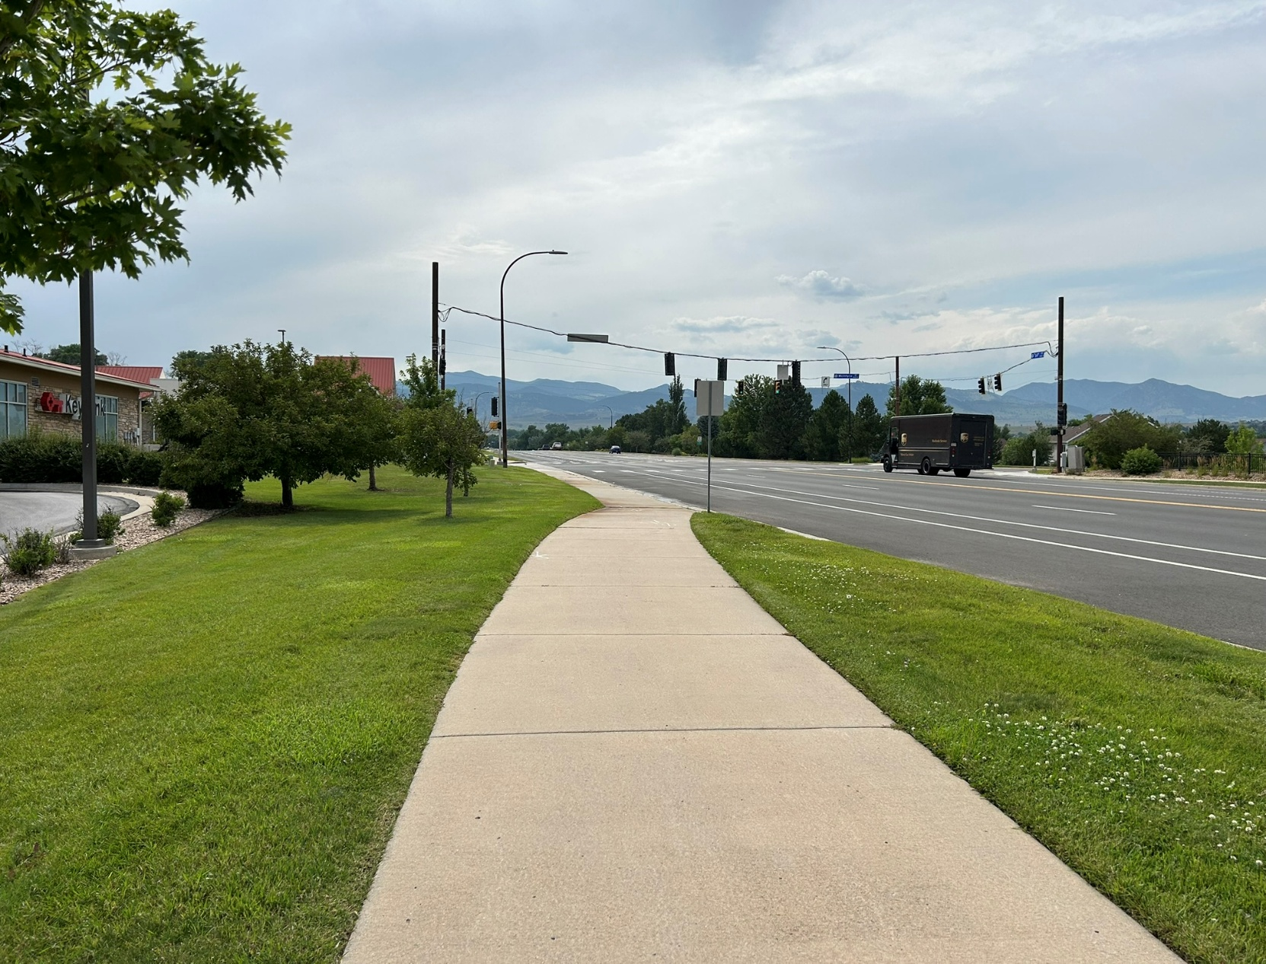
SB5 Applicable Areas
New development of commercial, institutional, industrial, common interest (HOA),
Street right-of-way, parking lot, medians, and transportation corridors
Redevelopment at 50%

Slide 19
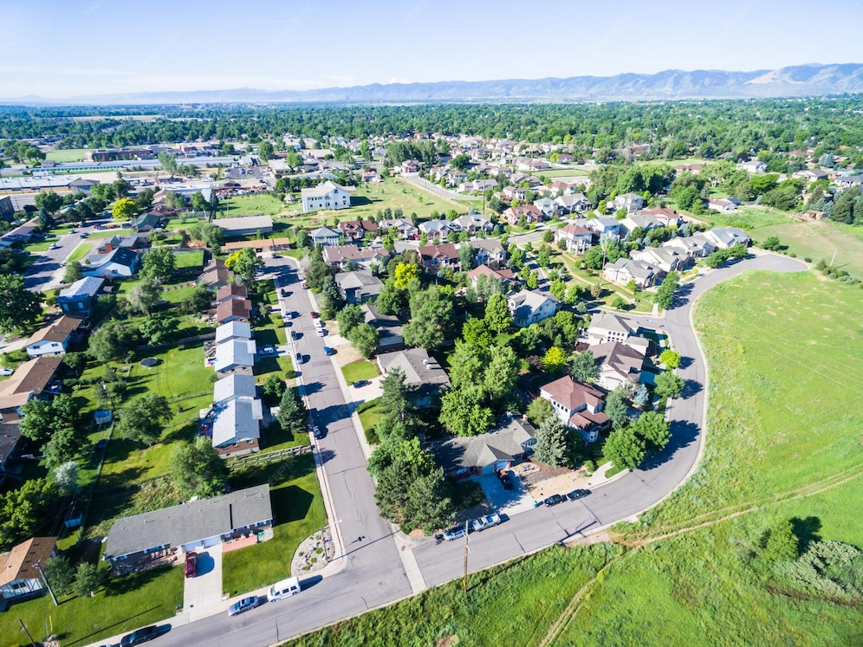
Limit Turf in New Residential Development (SB25-1113)
Extends SB5 Requirements to new and redeveloped multi-family properties
Also requires some level of non-functional turf restriction on new/residential landscapes by 2028
  Up to the local entity to define

Slide 20


Landscape Consultations
Expert Guidance
Non-Residential Properties
Increased 2026 Capacity
Learn More and
Submit Intake Form

Slide 21
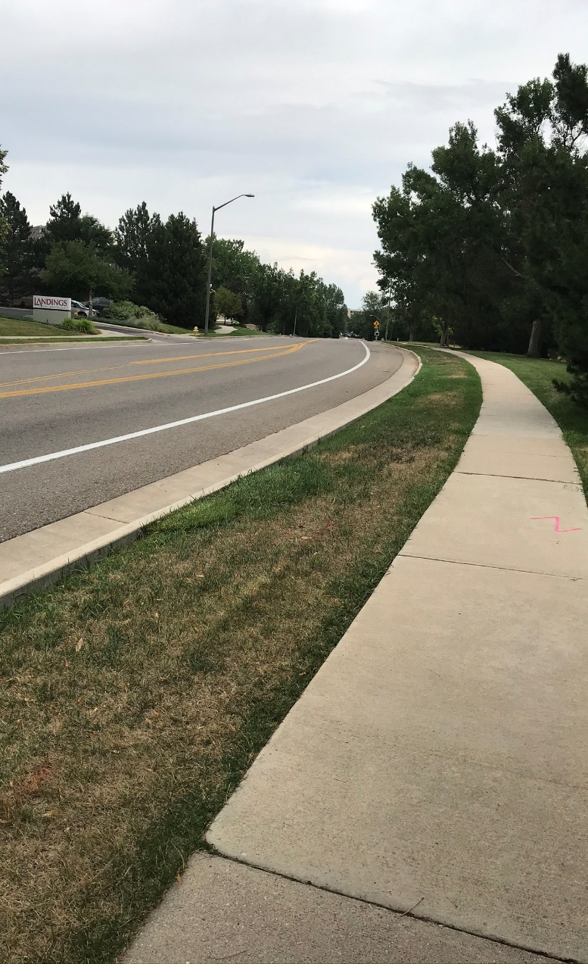
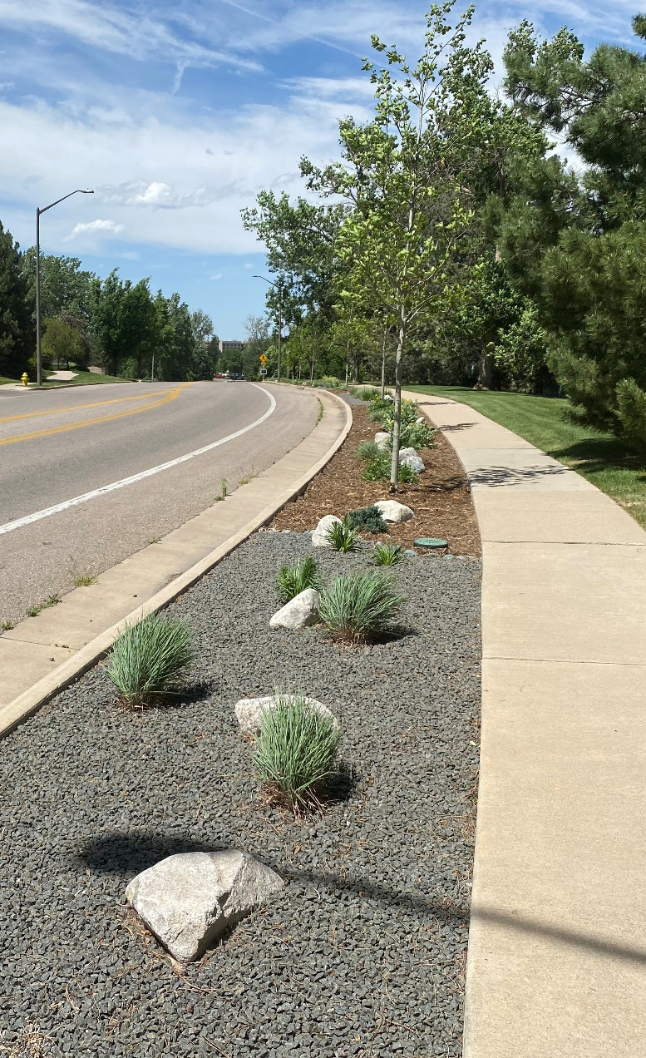
Collaborative Water-Efficient Landscape Grants
Up to $25k Matching Funds
Non-Residential Properties
Landscape Change or Irrigation Retrofit
Sattelite Demonstration Gardens
Before
After

Slide 22
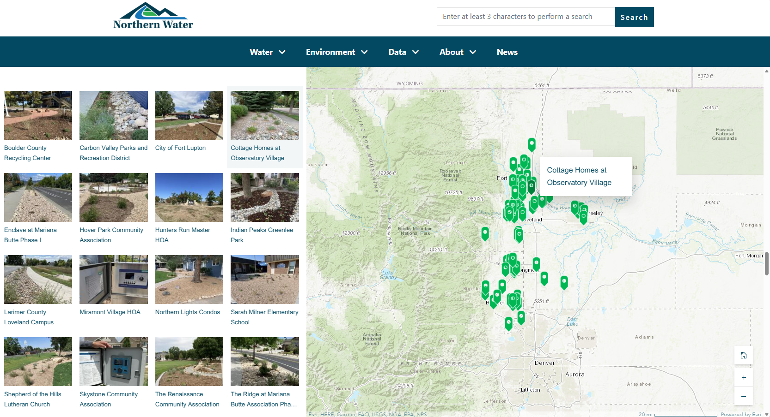

Grant Story Map
Scan to explore!

Slide 23
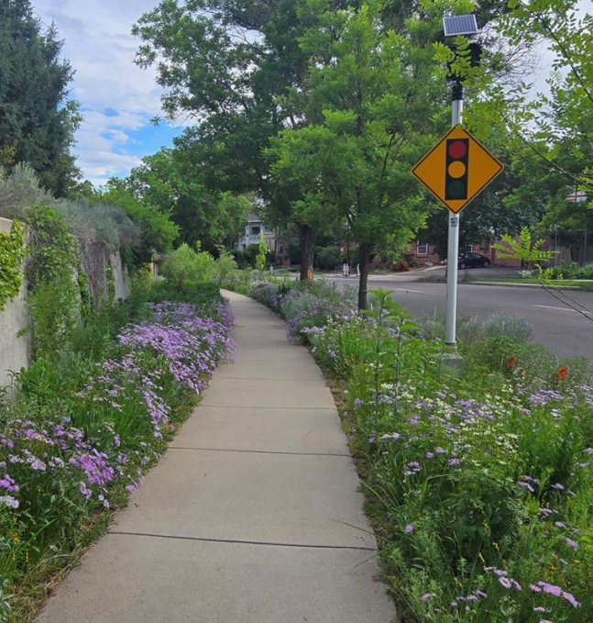
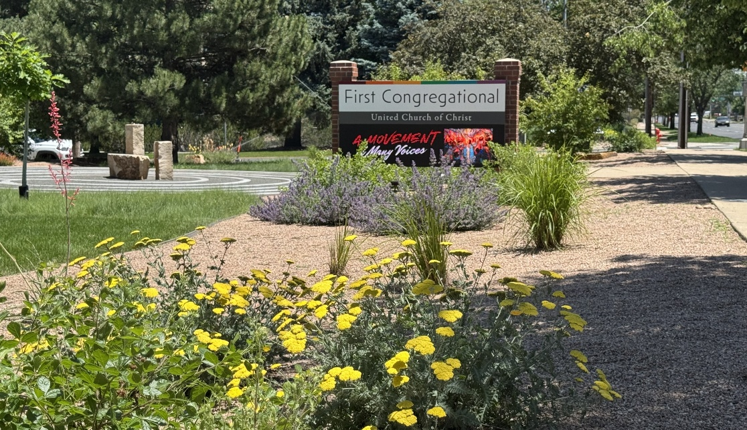
Movement Towards ColoradoScape
Water-Wise
Native & Adapted Plants
Climate Resilient
Beautiful and Colorful
Creates Habitat
Lower Maintenance

Slide 24
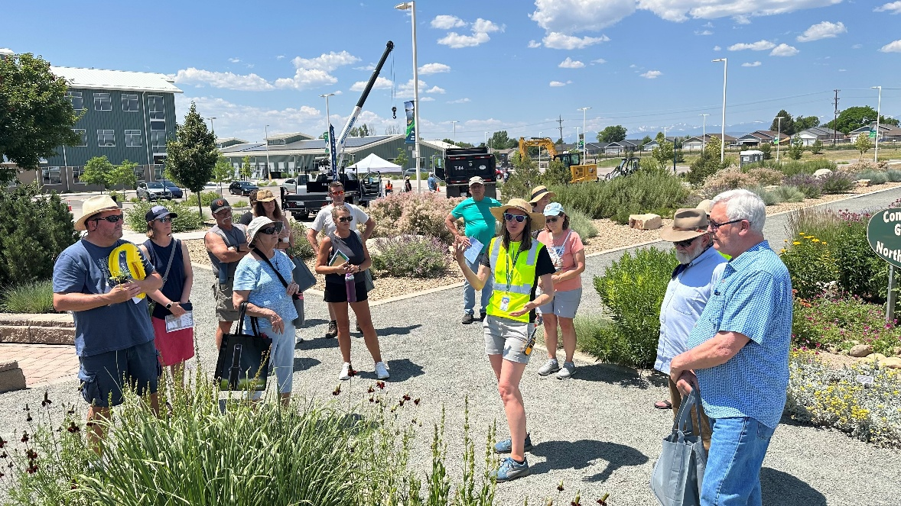
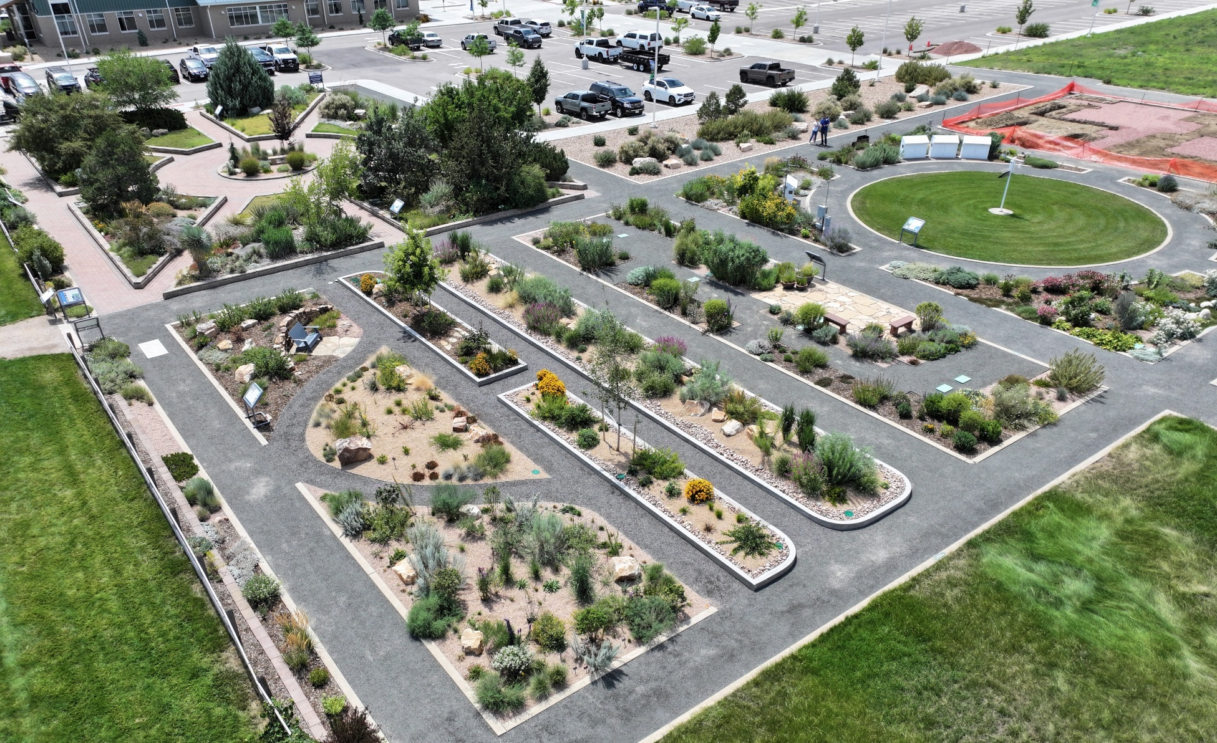

Conservation Gardens
Showcasing Drought-Ready Landscapes
Open Sunup-Sundown
Demonstrations
BMPs
Monthly Tours
Learn More Here

Slide 25


Slide 26
Pop Quiz: ColoradoScape or Not?

Slide 27
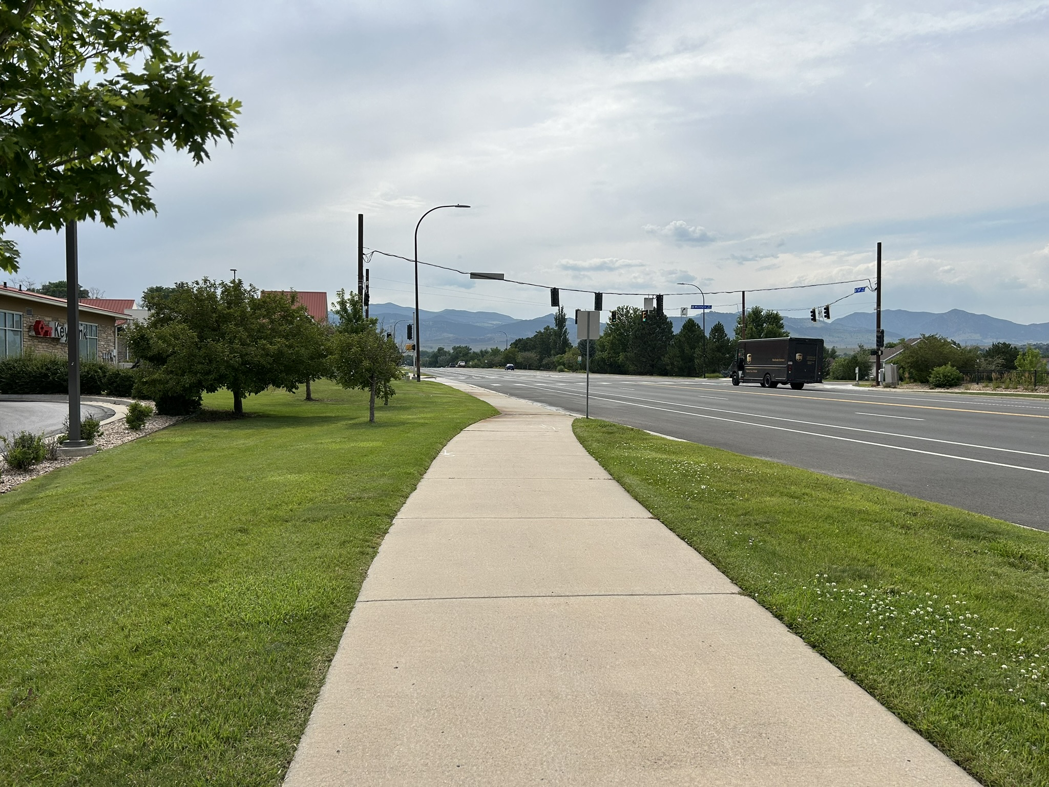

Slide 28
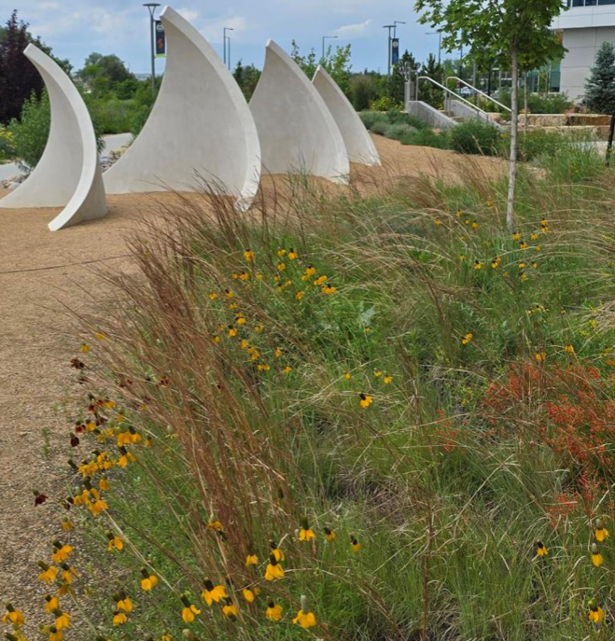


Slide 29
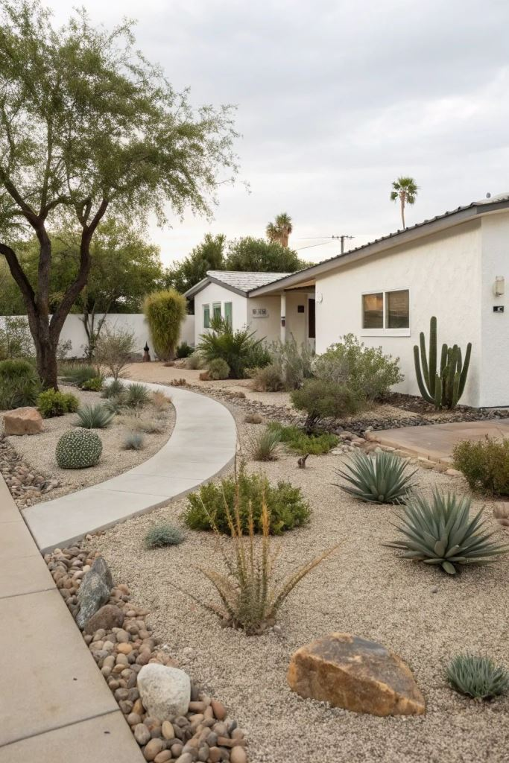

Slide 30
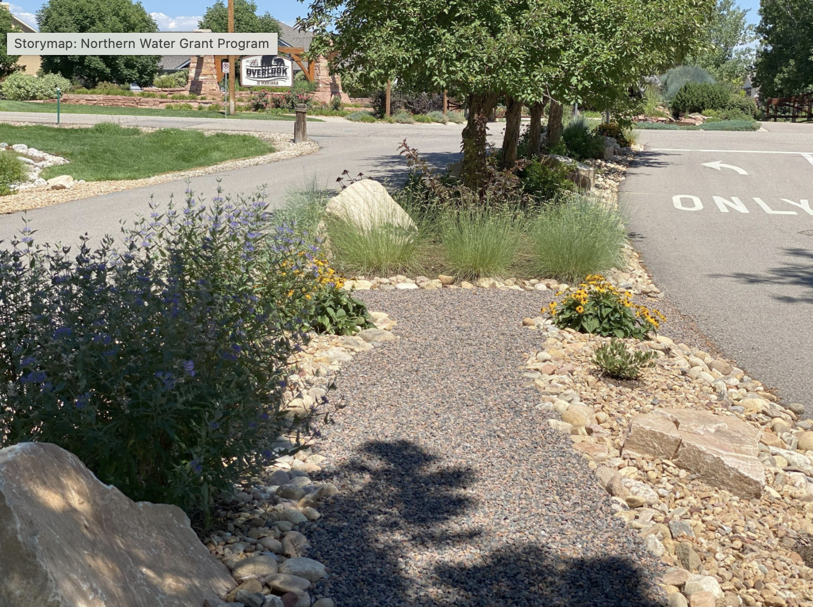

Slide 31
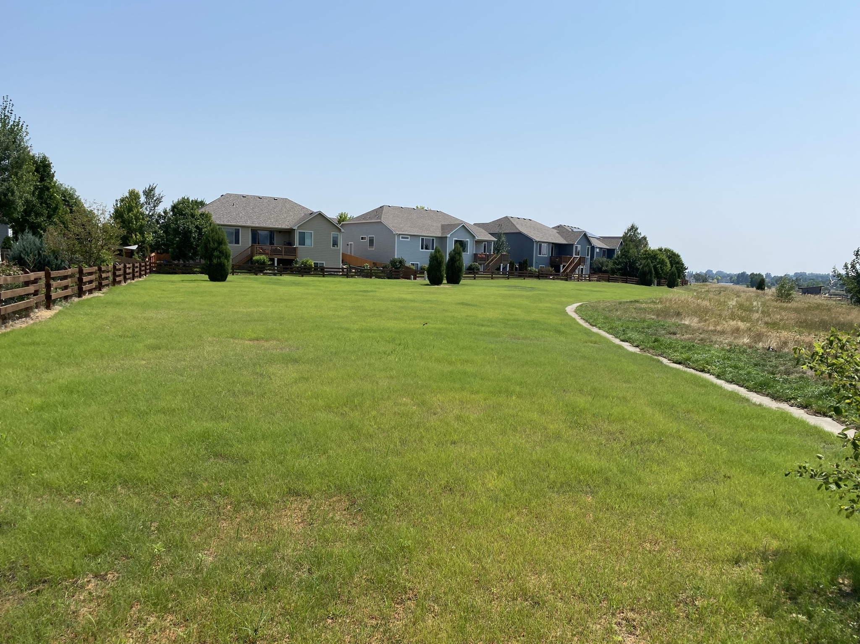

Slide 32
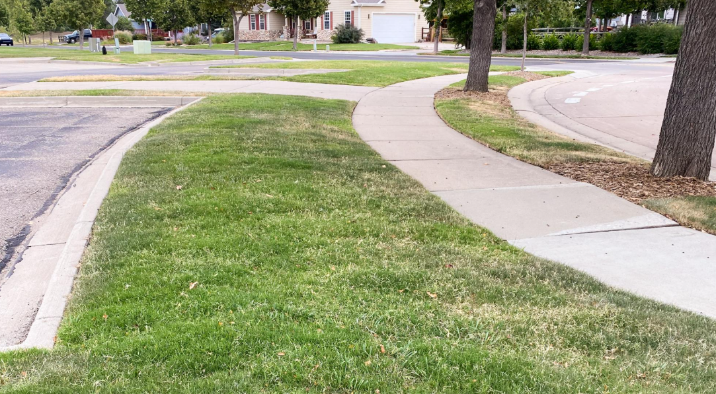

Slide 33
Thank You! Questions?
Darren Nowels dnowels@northernwater.org

